Slide 1
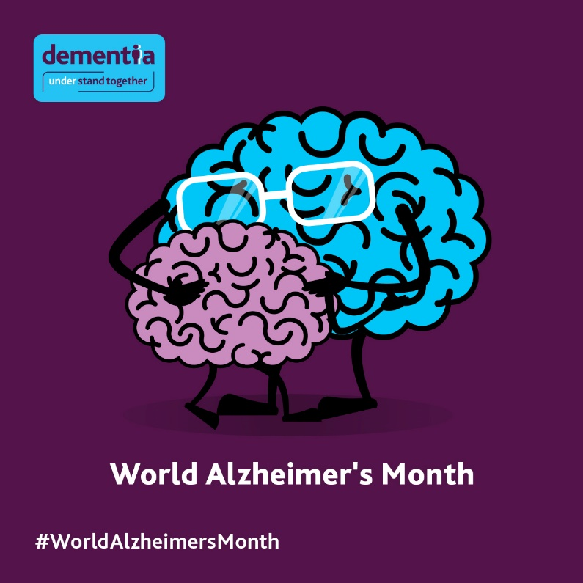
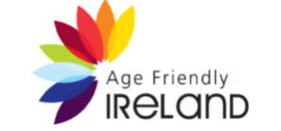
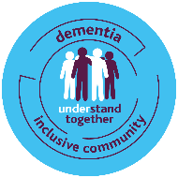
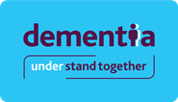
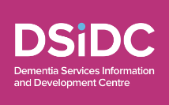
World Alzheimer’s Month - September 2023
Partner Pack for organisations and community champions

Slide 2
WAM takes place from the 1st – 30th of September 2023
This World Alzheimer's Month (WAM), the Dementia: Understand Together campaign is encouraging people and organisations to take simple actions to help raise awareness of dementia and the things we can do to improve and maintain our brain health.
The theme for WAM this year is “Never too early, never too late” with a focus on risk factors and risk reduction.
With the number of people living with dementia set to more than double by 2045, it has never been more important to recognise the risk factors associated with dementia and take proactive steps towards risk reduction. Through promoting brain health we hope to emphasise how by keeping our brain healthy we can delay and potentially prevent the onset of dementia, and encourage greater wellbeing for those with a diagnosis.
www.understandtogether.ie/get-involved

Slide 3
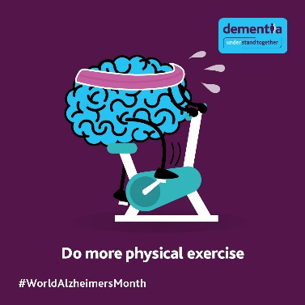
Social media posts and key messages
We would appreciate your support to help us raise awareness throughout the month by posting or sharing key messages on your own channels.
We’ve included some templates below which we hope are helpful. Where possible, please include links and hashtags.
Hashtags: #WorldAlzMonth #UnderstandTogether #NeverTooEarly #NeverTooLate #ReduceRiskNow #DementiaInclusiveCommunities
Please feel free to tag the Understand Together accounts in your own WAM posts and we’ll share/like what we can:
Facebook: @dementiaunderstandtogether
Twitter: @dementia_office
Facebook | Twitter | Image
September is #WorldAlzheimersMonth It's never too early or too late to take action to look after your brain health. Join us to raise awareness for dementia and the lifestyle changes that can help reduce your chances of developing it. Discover more ways to boost your brain health: www.understandtogether.ie/about-dementia/what-is-dementia/am-i-at-risk-/ #NeverTooEarly #NeverTooLate #ReduceRiskNow #UnderstandTogether | September is #WorldAlzheimersMonth. It's #NeverTooEarly or #NeverTooLate to reduce the risk of developing dementia. There are ways to boost your brain health and to support the health and wellbeing of people with dementia. Learn more: www.understandtogether.ie/about-dementia/what-is-dementia/am-i-at-risk-/ #UnderstandTogether | WAM23
Physical activity is important for brain health and exercise has been shown to reduce the risk of dementia. It’s never too early, or too late to get active. Adults should aim to include 150 minutes of physical activity in their week, this equates to a brisk 30-minute walk, five days a week. A brisk walk should raise your heart rate but not leave you breathless. #WorldAlzheimersMonth #ReduceRiskNow #UnderstandTogether | Physical activity is important for brain health and has been shown to reduce the risk of dementia. It’s #NeverTooEarly, or too late to get active. Adults should aim for 150 minutes of exercise a week, this equates to a brisk 30min walk, 5 days a week #WAM #UnderstandTogether | Exercise

Slide 4
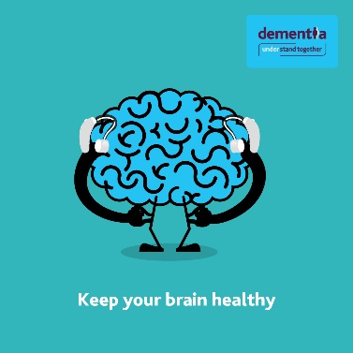
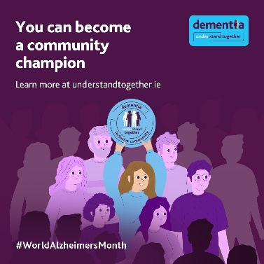
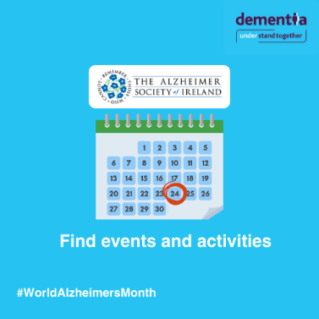
Social media posts and key messages continued
Facebook | Twitter | Image
Did you know that people with hearing loss are more at risk of developing dementia? If you or a loved one have noticed changes to your hearing recently, you should book a hearing test or visit your GP for advice. If needed, using hearing aids may help to reduce the risk. It’s never too early or too late to take action to improve your health and wellbeing. Learn more: www.hellobrain.eu/en/brainhealth/project?id=mind-your-hearing #WorldAlzheimersMonth #NeverTooEarly #NeverTooLate #ReduceRiskNow | Did you know that people with hearing loss are more at risk of developing dementia? If you’ve noticed a change, book a hearing test or visit a GP. If needed, using hearing aids may help reduce the risk. Learn more: www.hellobrain.eu/en/brainhealth/project?id=mind-your-hearing #WorldAlzheimersMonth #UnderstandTogether | Hearing aid image
 |  | Community champion
Over 64,000 people are living with dementia in Ireland and at least 63% live in the community. It’s never too early to start building a dementia inclusive community, and it’s never too late to show you care. Helping people in your community to stay socially connected and active can help slow the progression of the condition and improve outcomes for people affected by dementia. Find out more: www.understandtogether.ie/get-involved #WorldAlzheimersMonth #NeverTooEarly #NeverTooLate #DementiaInclusiveCommunities | Over 64k people have dementia in Ireland. It’s never too early to build dementia inclusive communities, or too late to show you care. Supporting people to stay connected can help slow progression and improve outcomes: www.understandtogether.ie/get-involved #DementiaInclusiveCommunities #WAM
 |  | ASI
The Alzheimer’s Society of Ireland will be sharing a helpful calendar of activities taking place across the county and online during #WorldAlzheimersMonth Find out more and sign up for local and national events at: https://alzheimer.ie/ | @alzheimersocirl will be sharing a helpful calendar of activities taking place across the county and online during #WorldAlzheimersMonth Find out more and sign up for local and national events at: https://alzheimer.ie #NeverTooEarly #NeverTooLate

Slide 5
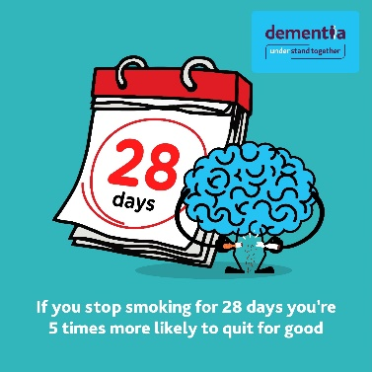
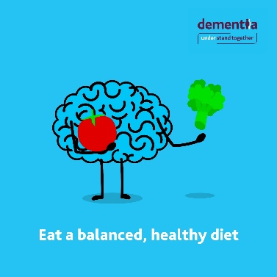
Social media posts and key messages continued
Facebook | Twitter | Image
Smoking greatly increases your risk of developing dementia. It also increases your risk of other conditions, including type 2 diabetes, stroke, lung and other cancers. It’s #NeverTooLate – stopping smoking later in life can still reduce the risk. If you’re ready to quit, the HSE QUIT team are ready to help. For free support call 1800 201 203 or visit www.quit.ie #WorldAlzheimersMonth #NeverTooEarly #ReduceRiskNow #UnderstandTogether | Smoking increases your risk of developing dementia. It’s #NeverTooLate, stopping later in life can still reduce the risk. If you’re ready to quit, the HSE QUIT team are ready to help. For free support call 1800 201 203 or visit www.quit.ie #WorldAlzheimersMonth | Smoking
A nutrient rich and balanced diet, that is low in salt and sugar and includes vegetables, fruit, wholegrains, lean meat and fish, can provide the energy and nutrients you need to keep your brain healthy. It’s never too early or too late to take action to reduce your likelihood of developing dementia. Achieving or maintaining a healthier weight during your lifetime, particularly in mid-life is also important; being more active and following a healthy diet can help this. Learn more: www.understandtogether.ie/training-resources/hello-brain/ #WorldAlzheimersMonth #ReduceRiskNow | It’s #NeverTooEarly or too late to take action to reduce your risk of developing dementia. Eating a healthy, nutrient rich and balanced diet and maintaining a healthy weight are changes you can make to help. Learn more: www.understandtogether.ie/training-resources/hello-brain/ #WorldAlzheimersMonth #ReduceRiskNow | Healthy eating

Slide 6
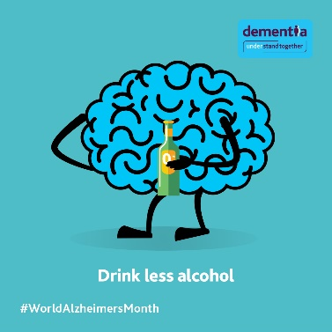
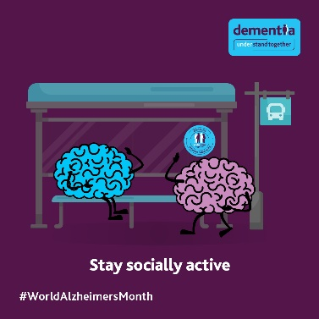
Social media posts and key messages continued
Facebook | Twitter | Image
Reducing your alcohol consumption can reduce your risk of developing dementia and many other conditions. Weekly low risk guidelines recommend no more than 17 standard drinks (a half pint of beer or small glass of wine) a week for men or 11 standard drinks for women and drinks should be spread out across the week. For more information, advice and support call the HSE Alcohol Helpline on 1800 459 459 or visit www.askaboutalcohol.ie #WorldAlzheimersMonth #ReduceRiskNow #NeverTooEarly #NeverTooLate #UnderstandTogether | Reducing alcohol consumption can reduce your risk of developing dementia. Weekly low risk guidelines are no more than 17 standard drinks a week for men or 11 for women. For more information and support call the HSE Alcohol Helpline on 1800 459 459 or visit www.askaboutalcohol.ie | Alcohol
Keeping up with hobbies and staying connected and active can help to reduce your risk of developing dementia and can slow down the progression of dementia. Programmes such as Azure and gallery tours are specifically designed to be dementia inclusive. They are a great opportunity to support anyone with dementia to get involved. Our partners at IMMA and the National Gallery both have exhibits, tours and activities for all to enjoy, visit: https://imma.ie/learn-engage/families-community/dementia-inclusive/about-azure/ #WorldAlzheimersMonth #UnderstandTogether #DementiaInclusiveCommunities | Keeping up with hobbies can help to reduce your risk of developing dementia and slow progression. The Azure programme is #dementiainclusive Our partners @IMMAIreland and @NGIreland both have activities for all to enjoy, visit: www.nationalgallery.ie/what-we-do/education-department/access-programme/dementia https://imma.ie/learn-engage/families-community/dementia-inclusive/about-azure/ #WAM | Socially active

