Slide 1
European Cervical Cancer Prevention Week:
#GetInformed about cervical cancer elimination
Partner Pack
23 January 2023
Slide Templates
For HSE and Funded Agencies

Slide 2
European Cervical Cancer Prevention Week
23-29 January: Get informed about cervical cancer elimination
Everyone can help prevent cervical cancer by getting informed about the causes of cervical cancer; about the link between cervical cancer and the human papillomavirus (HPV); and about how HPV vaccination, cervical screening, early treatment and symptom awareness are key tools in our fight against cervical cancer.
What we want everyone to know…
Cervical cancer is preventable, and can be successfully treated, if it is detected early and managed effectively
What cervical cancer is, and how to reduce the risk of developing it
How cervical cancer is linked to HPV
How vaccination can protect you against HPV, and of cervical cancer developing
The role of cervical screening in reducing the incidence and impact of cervical cancer
The symptoms of cervical cancer and where to go if you are experiencing them

Slide 3
About cervical cancer
Each year in Ireland, 300 women get cervical cancer and 90 die from it.
Cervical cancer mostly affects people aged 30 to 50 who have ever been sexually active. In women aged 25 to 39, cervical cancer is the second most common cause of death due to cancer. Cervical cancer is very rare in people under 25. It does not run in families.
Almost all cases of cervical cancer (approx. 90%) are caused by the human papillomavirus (HPV).
HPV is the name for a very common group of viruses. Most people will have HPV at some point in their lives. You can get it from any kind of sexual contact of the genital area, not just penetrative sex. You can have HPV even if you’ve only had one partner or are not currently or recently sexually active.
Most HPV infections don’t need treatment because your immune system can clear the virus itself within 18 months. Cervical cancer is a rare outcome of a HPV infection but in some people, if the HPV persists it can cause changes in the cells of the cervix that can become cancer over time.
It usually takes 10 to 15 years for these abnormal cells to become cancer. But in rare cases, it can develop quicker.

Slide 4
Cervical cancer elimination
Elimination of cervical cancer is achieved when fewer than 4 cases of cervical cancer are diagnosed for every 100,000 women and people with a cervix in its population.
Elimination means we will reduce the number of people diagnosed with cervical cancer so that it’s a rare disease.
Cervical cancer can be successfully treated if detected early and managed effectively. You can reduce your risk of developing cervical cancer through:
regular HPV cervical screening when eligible
getting the HPV vaccine when eligible
not smoking
What will elimination mean?
Achieving elimination will make cervical cancer a rare disease, save lives and greatly reduce the need for invasive, often life-changing treatment.
How we will do it
By using the tools of vaccination, HPV cervical screening and early treatment to prevent or reduce the risk of the disease occurring, and its impact.
A roadmap towards elimination has been created by a HSE strategic group led by the National Screening Service, National Immunisation Office and the National Cancer Control Programme and including the Irish Cancer Society, patient representatives and the Department of Health.

Slide 5
Key messages
In support of European Cervical Cancer Prevention Week (23-29 January), we are encouraging all women and people with a cervix aged 25 to 65 to attend their free HPV cervical screening tests regularly. https://www2.hse.ie/cervical-screening/
The HPV vaccine protects against 9 out of 10 cervical cancers. It protects young people from most HPV-related cancers when they are older. The more young people vaccinated, the closer we will get to eliminating cervical cancer. The vaccine is offered to all children in first year of secondary school. This year, people who didn’t get the vaccine when it was offered to them in school, could be eligible now, as part of the Laura Brennan Catch-Up Programme. See more on www.hpv.ie #ThankYouLaura
You can reduce your risk of developing cervical cancer by:
attending HPV cervical screening regularly
getting the HPV vaccine, if eligible
not smoking
Help eliminate cervical cancer and make it a rare disease in Ireland. https://www2.hse.ie/conditions/cervical-cancer/overview/
HPV cervical screening looks for the types of HPV that cause almost all cervical cancers. It is one of the best ways of preventing cervical cancer, and catching cervical cancer early when it can be easier to treat. https://www2.hse.ie/cervical-screening/
CervicalCheck offers free cervical screening for women and people with a cervix aged 25 to 65. Screening is not a test for cancer – it's a test to see if you are at risk of developing cancer in the future. Find out more at https://www2.hse.ie/cervical-screening/
Make sure we have the correct details for you so that we can send you a reminder letter when your appointment is due. Check the register https://www2.hse.ie/conditions/cervical-screening/why-go/register/

Slide 6
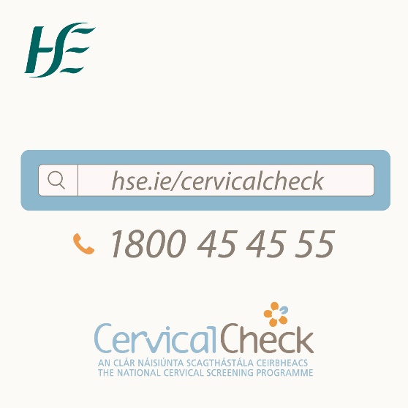
European Cervical Cancer Prevention Week
European Cervical Cancer Prevention Week runs from 23-29 January 2023.
This week we will also continue to highlight that HPV cervical screening is one of the best ways of preventing cervical cancer, and catching cervical cancer early when it can be easier to treat. We will also communicate about our goals to eliminate cervical cancer, to make it a rare disease.
We will communicate and engage with our 25-65 year old audience through radio and social media ads. These channels are supported by our ongoing paid search ads.
Our paid media will be supported by a press release and interviews with a number of media outlets.
You can listen to the radio ad here.

Slide 7
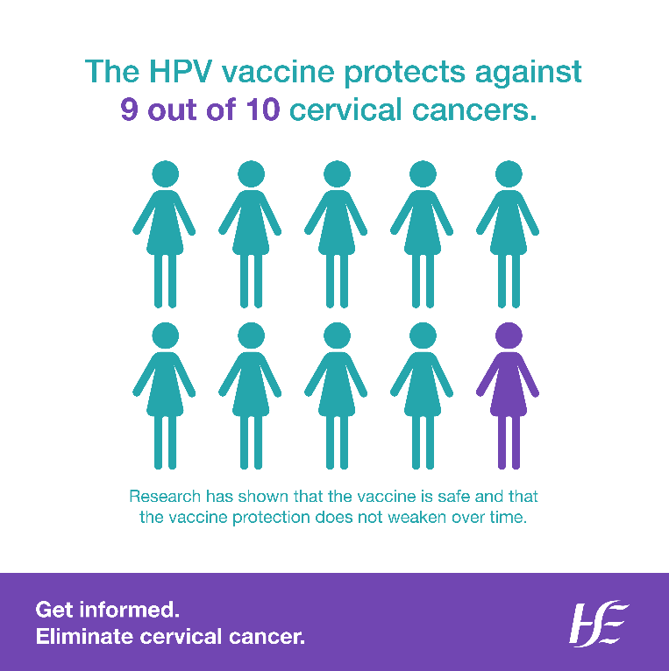
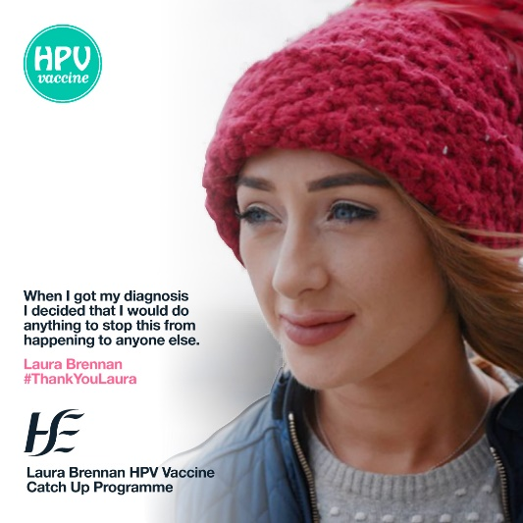
Support the campaign
We welcome your support in sharing the campaign messages. Right click on images to save them.
In support of European Cervical Cancer Prevention Week (23 to 29 January), we are encouraging all women and people with a cervix aged 25 to 65 to attend their free HPV cervical screening tests regularly.
https://www2.hse.ie/cervical-screening/
The HPV vaccine protects against 9 out of 10 cervical cancers. It protects young people from most HPV-related cancers when they are older. The more young people vaccinated, the closer we will get to eliminating cervical cancer. Find out more here:
https://www.hse.ie/eng/health/immunisation/pubinfo/schoolprog/hpv/hpv-human-papillomavirus/about/
You can share our video on How effective is HPV cervical screening, available here: https://www.youtube.com/watch?v=ExCxoTPqMv0
Find all messages on our social media channels: Facebook: www.facebook.com/cervicalcheck
Twitter: @HSELive
TikTok: @hselive
If you have any queries, please contact communications@screeningservice.ie
The HPV vaccine is offered to all students in first year of secondary school. This year, people who didn’t get the vaccine when it was offered to them in school, could be eligible now, as part of the Laura Brennan Catch-Up Programme. www.hpv.ie #ThankYouLaura
Hashtags: #ECCPW | #EliminateCervicalCancer | #GetInformed

Slide 8
Support the campaign
You can share our video on ‘How effective is HPV cervical screening’, available here: https://www.youtube.com/watch?v=ExCxoTPqMv0
Find all messages on our social media channels: Facebook: www.facebook.com/cervicalcheck
Twitter: @HSELive
TikTok: @hselive
If you have any queries, please contact communications@screeningservice.ie
You can share our video on How effective is HPV cervical screening, available here: https://www.youtube.com/watch?v=ExCxoTPqMv0
Find all messages on our social media channels: Facebook: www.facebook.com/cervicalcheck
Twitter: @HSELive
TikTok: @hselive
If you have any queries, please contact communications@screeningservice.ie

