Slide 1
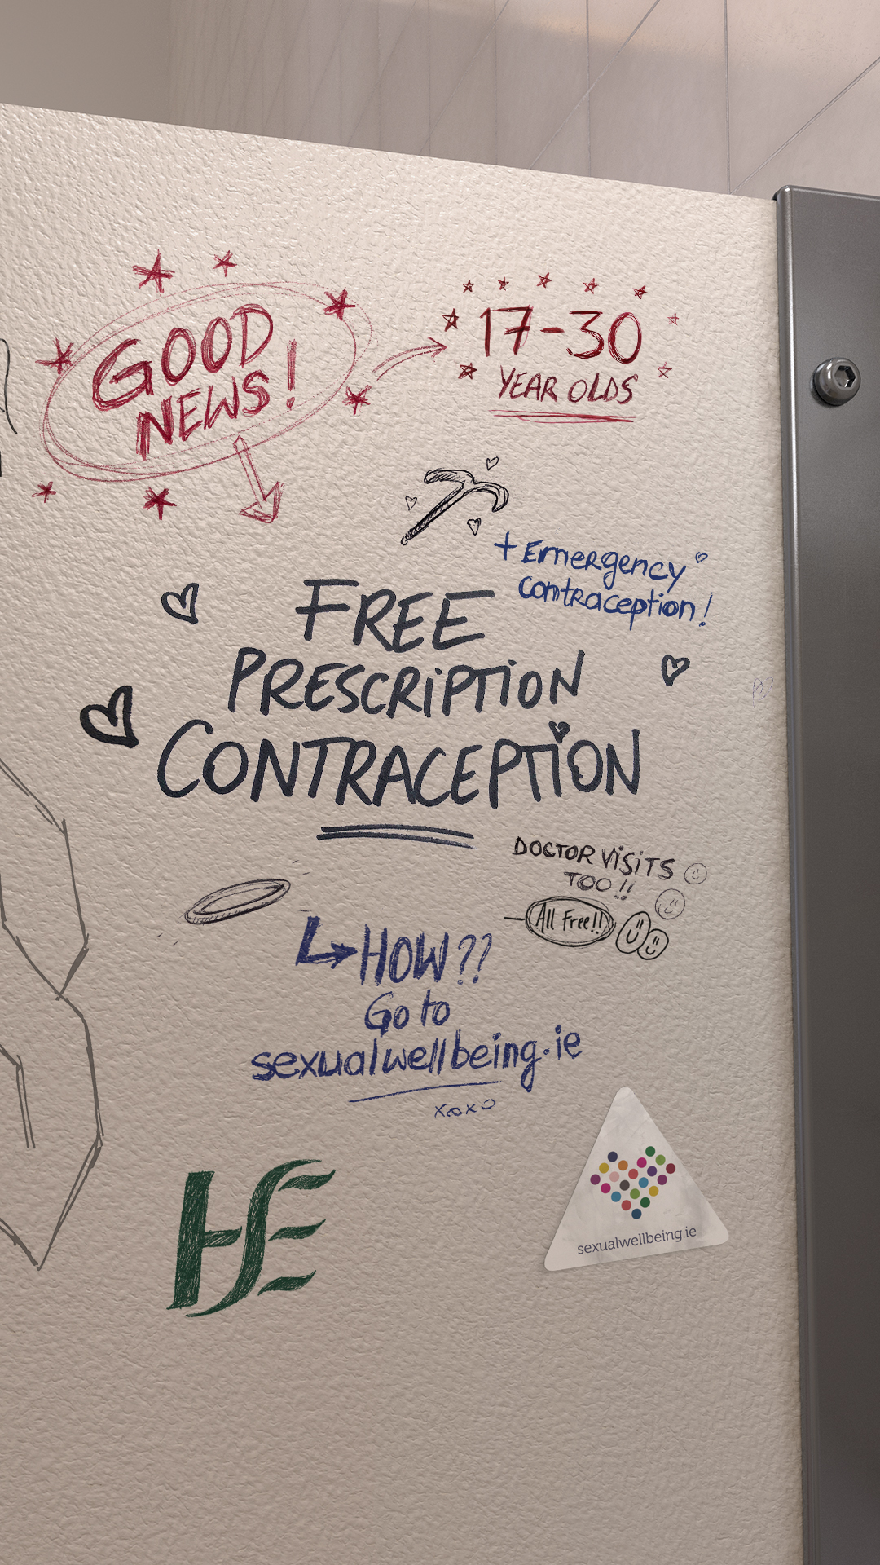
Free prescription and emergency contraception for 17-30 year olds
Campaign Partner Pack
September 2023

Slide 2
Campaign Overview
On 14 September 2022, the Government launched a free prescription and emergency contraception service for 17 to 25 year olds. This was extended to 17 to 26 year olds in January 2023.
From Friday 1st September 2023, this service will be available to 17 to 30 year olds.
The service includes consultations with your doctor, prescriptions, emergency contraception and more. Information about the free contraception service is available at: https://sexualwellbeing.ie/sexual-health/contraception/free-contraception/
Resources and information about contraception and sexual wellbeing are available to support people with their sexual and reproductive health at: https://sexualwellbeing.ie/sexual-health/contraception/

Slide 3
Campaign Approach
The campaign is inspired by peer-to-peer, informal ways and methods of sharing news which are familiar to young people in the target age group.
The visual approach for Out of Home (OOH) posters and digital assets is inspired by the places where peer talk naturally happens. In this case, the messages which are often shared informally on bathroom walls.
The radio and audio assets are based on ‘voice notes’ and features three friends sharing the good news about free contraception.

Slide 4
Campaign channels and assets
On air 4 September 2023
Our message – Free prescription and emergency contraception is now available if you are between 17 – 30. Find out more at sexualwellbeing.ie
Radio - Radio ads on national, local and digital audio (Spotify). Listen to the radio ad here.
Out of home (OOH) - Digital OOH, including bus shelter and iVision locations nationwide.
Digital and Social media – Digital display advertising, Search advertising and social media messages across Facebook, Instagram, Snapchat and TikTok from Friday 1 September.

Slide 5
How can you help?
We welcome your ongoing support and partnership.
You can support this new announcement by sharing our messages as they appear on HSE Sexual Wellbeing social media channels.
You might also be interested in ordering promotional posters or information guides from HealthPromotion.ie, these are available free of charge.
The next section of this pack includes information on how to order/support.

Slide 6
Campaign assets

Slide 7
Campaign assets overview
Order promotional posters
Instructions on how to order posters and resources from HealthPromotion.ie
Contraception guide
Social media assets and channels
Contact information

Slide 8
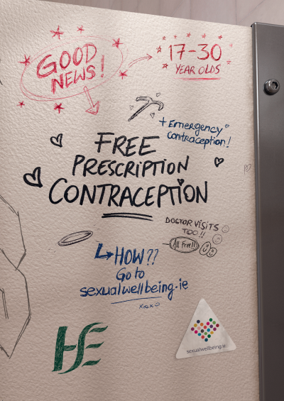
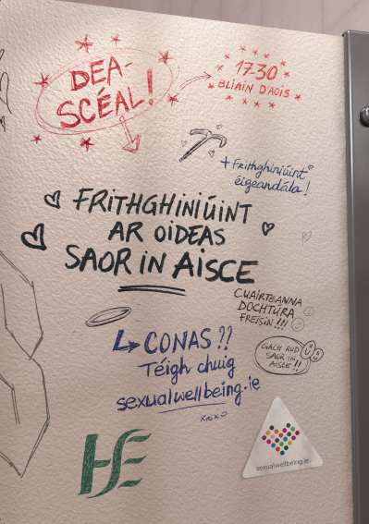
1. Order free posters
Posters advertising the free contraception service are available to order on HealthPromotion.ie
Posters are available to order in both English and Irish and in A3 and A4 size.
Search by topic [Sexual Health] and keyword [Contraception] to find these posters.
Further instructions on how to order from HealthPromotion.ie in the next slide.
12345

Slide 9
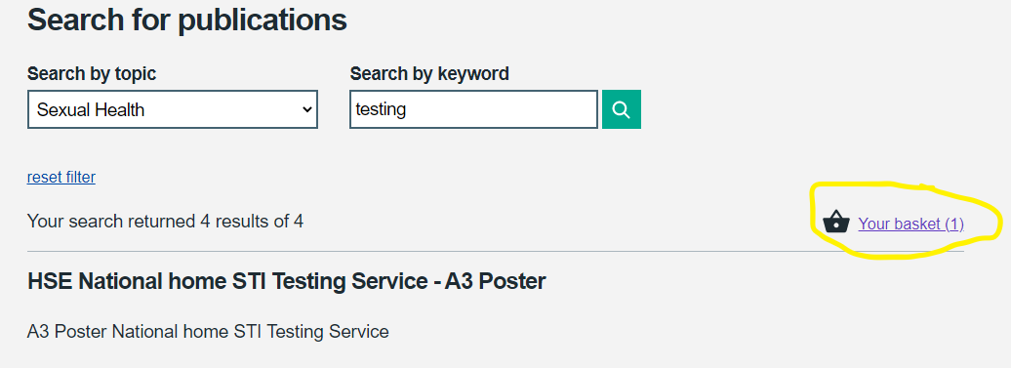
2. How to order from HealthPromotion.ie
The HSE produce and distribute a wide range of health related resources, including sexual health posters and guides. These are all available to order on HealthPromotion.ie
If you have not used HealthPromotion.ie in the past, you will need to set up an account. Simply complete a short sign up form, registering as a professional, on this page.
Once you have signed in, use the search function to browse through all resources available. To order a resource, input the quantity you need, and click “Add to basket”.
When you are ready to place an order, click the basket icon to confirm and complete your delivery details.

Slide 10
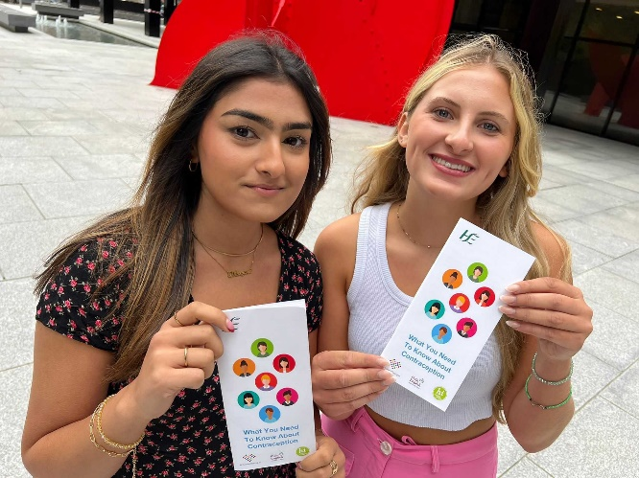
3. Contraception guide
HealthPromotion.ie also has lots of guides available to order free of charge such as ‘What you need to know about Contraception’.
This plain English guide provides information about 11 different types of contraception available, as well as emergency contraception.
The information in this guide is also available online:
https://sexualwellbeing.ie/sexual-health/contraception/resources/
It has been translated into ten languages, all available online and to order on https://healthpromotion.ie
Browse through the range of resources available to download or order on HealthPromotion.ie by searching the topic: “Sexual Health”
12345

Slide 11
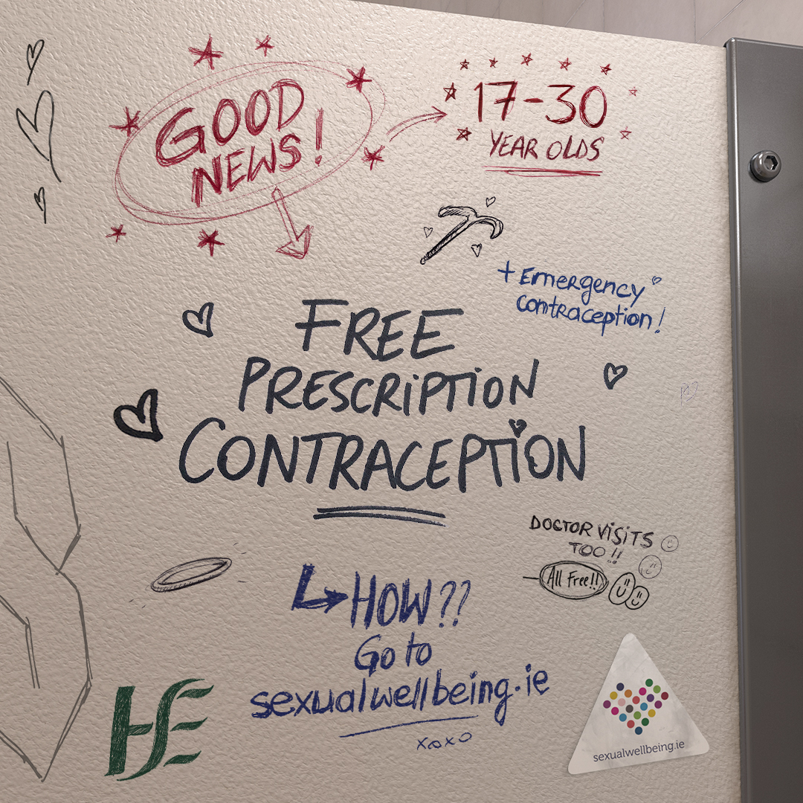
4. Social media
If you would like to share a social media update about the availability of free contraception to 17-30 year olds, please feel free to use these images which are sized for social media (9x16 and 1x1).
Sample caption:
Free prescription and emergency contraception is now available if you are aged between 17 – 30. Find out more at sexualwellbeing.ie
Some suggested hashtags: #SexualWellbeing #FreeContraception #contraception #WomensHealth #SexualHealth #EmergencyContraception

Slide 12
4. Social Media - continued
From Friday 1 September, information about the free contraception service will be shared on the HSE Sexual Wellbeing campaign’s social channels.
You are welcome to share these posts and videos. You can find Sexual Wellbeing on the following platforms:
Facebook: @Sexual Wellbeing
Instagram: @hserespectprotect
Tiktok: @sexualwellbeing.ie
As well as content about the free service, you will find content about contraceptive choices on these channels, such as the “All about Contraception” video series, presented by Dr Ciara McCarthy ICGP/HSE GP Clinical Lead in Women’s Health. This series is also available to view on the HSE Ireland Youtube channel.

Slide 13
5. Contact Information
Thank you for sharing this campaign.
For queries or ideas, please contact:
Muireann Kirby, HSE Programmes and Campaigns, muireann.kirby@hse.ie
Róisín Guiry, HSE Programmes and Campaigns, roisin.guiry@hse.ie

