Slide 1
SunSmart Campaign
Partner Pack
April to September 2024

Slide 2
Campaign overview
The annual SunSmart campaign is run by the HSE’s National Cancer Control Programme (NCCP), in collaboration with Healthy Ireland and cross-sectoral partners. We are working together to support people to reduce their risk of skin cancer by protecting their skin from the sun.
The aim of the campaign is to reduce your risk of skin cancer by increasing awareness and engagement with:
the steps you, your family, friends and colleagues can take to protect your skin from the sun
not using sunbeds
This partner pack contains information, video links and image links for your use and to share with your own networks to support the 2024 SunSmart campaign.

Slide 3
Campaign key messages
Skin cancer is the most common form of cancer in Ireland with over 11,000 cases diagnosed annually (NCRI, 2023).
The number of people being diagnosed with skin cancer in Ireland is rising rapidly. Yet skin cancer is largely preventable by protecting skin from UV rays and not using sunbeds.
Protecting your skin from the sun whether at home or abroad can reduce your risk of skin cancer.

Slide 4
Campaign key messages
Protect yourself and children by being SunSmart as part of your daily routine especially from April – September even when it’s cloudy in Ireland. Follow the Healthy Ireland SunSmart 5 S’s:
Slip on clothing,
Slop on sunscreen,
Slap on a wide-brimmed hat,
Seek shade,
Slide on sunglasses.
As well as the 5 S’s it is important to remember
Do not deliberately try to get a suntan. Remember tanned skin is damaged skin
Avoid getting a sunburn
Never use a sunbed
No sunscreen can provide 100% protection, it should be used alongside other protective measures such as clothing and shade.

Slide 5
Campaign key messages
Playing and spending time outdoors is good for your child. But it is important to protect their skin when outside in the sun.
Getting too much sun can be harmful whatever your age. It exposes your skin to UV rays that can damage your skin and lead to skin cancer. Enjoy time out in the sun while also protecting your skin and being SunSmart.
If you work outdoors, you are exposed to 2-3 times higher amounts of UV from the sun than people who work indoors, putting you at higher risk of developing skin cancer.
Make sure to protect your skin from the sun while getting the health benefits of being active outdoors.
Getting a tan from a sunbed increases your risk of developing skin cancer. There is no safe limit of exposure to UV radiation from sunbeds. It is never safe to use a sunbed.

Slide 6
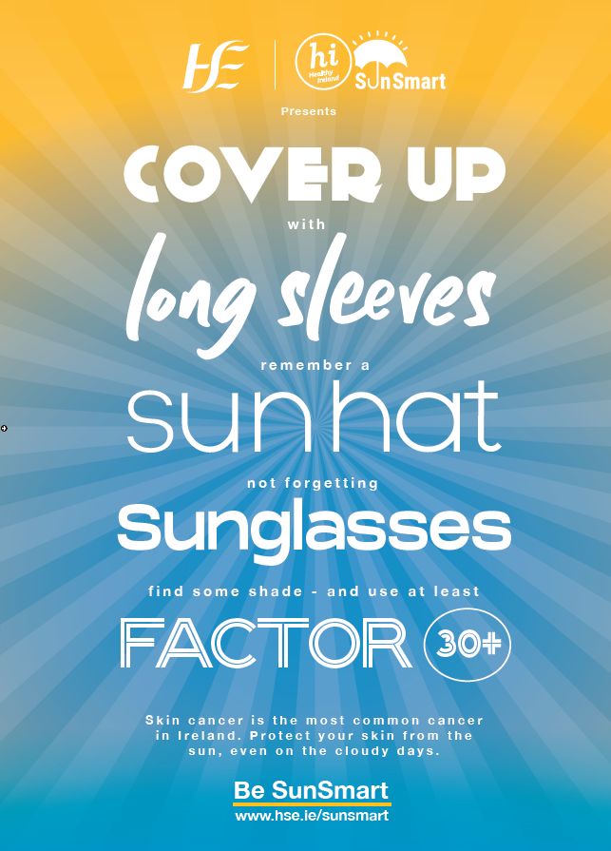
Campaign channels
Radio ads will run on national, local and digital radio from May to August 2024. Listen to our ads below:
Radio ad in English and Irish
Out-Of-Home ads will run on Dublin Bus and Dart from 1 June to 14 July
(ad featured to the right).
A range of press activity will roll out from April to September.
Social media messages will run across Facebook, Instagram, Twitter,
YouTube, TikTok and Snapchat from April to September.

Slide 7
How can you help?
We welcome your ongoing support and partnership.
You can support this campaign by sharing our messages as they appear on HSE and Healthy Ireland’s social media channels or posting content to your social media channels or events you are planning using #SunSmart.
For newsletter, e-zine or publication article ideas contact us at prevention@cancercontrol.ie
You might also be interested in downloading and printing awareness posters or ordering information resources from www.HealthPromotion.ie, these are available free of charge.
The next section of this pack includes information and resources for you on how to support the campaign.

Slide 8
Campaign resources and social media assets

Slide 9
Campaign assets overview
Download and print promotional posters
Instructions on how to order guides and resources from HealthPromotion.ie
Social media assets and channels
Social media videos
Contact information

Slide 10
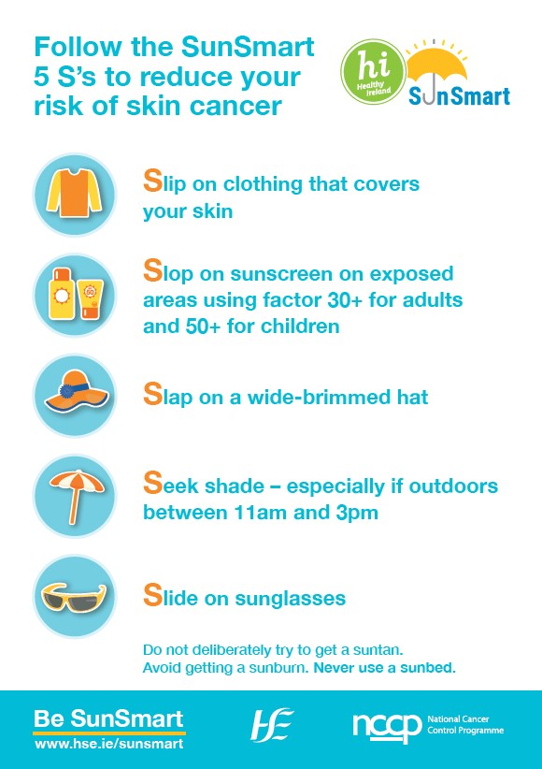
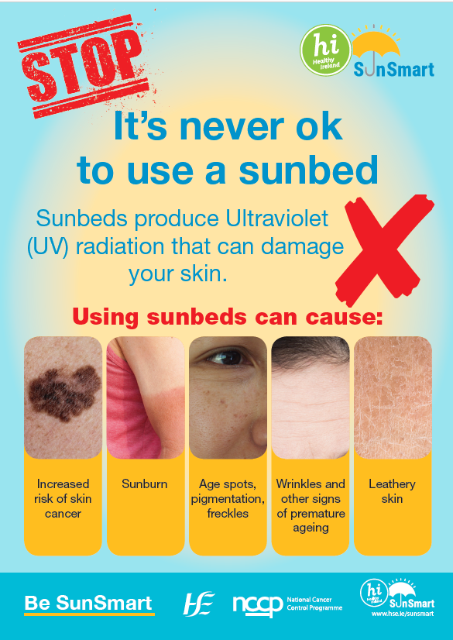
1. Download and print posters
SunSmart posters and leaflets are available to download and order hard copies on www.HealthPromotion.ie
Posters are available in A3 size.
Search by topic [Cancer] to find these posters.
Further instructions on how to access HealthPromotion.ie resources in the next slide.
12345

Slide 11
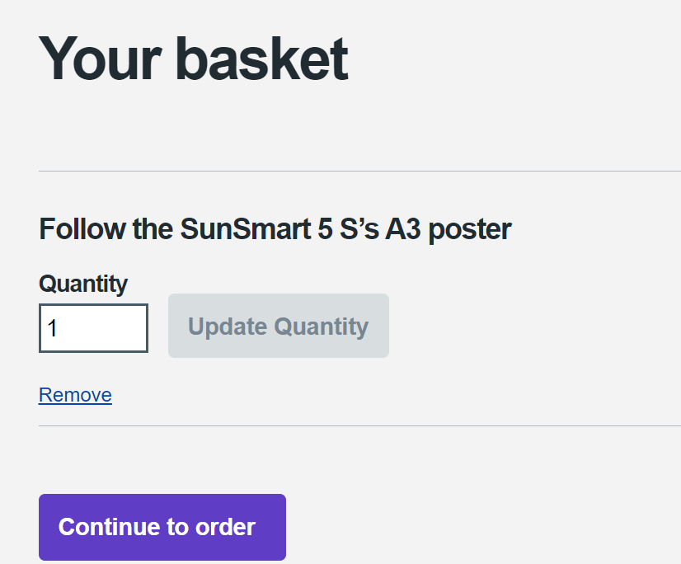
2. How to order from HealthPromotion.ie
The HSE produce and distribute a wide range of health-related resources, including SunSmart posters and leaflets. These are all available to order on HealthPromotion.ie
If you have not used HealthPromotion.ie in the past, you will need to set up an account. Simply complete a short sign up form, registering as a professional, on this page.
Once you have signed in, use the search function to browse through all resources available. To order a resource, input the quantity you need, and click “Add to basket”.
When you are ready to place an order, click the basket icon to confirm and complete your delivery details.

Slide 12
3. Social media assets and channels
We welcome you supporting the SunSmart campaign by posting content to your social media channels using the hashtag #SunSmart.
We will post content on our social media channels listed below for you to re-share.
X (formerly Twitter) handles: @HSELive @hseNCCP @HealthyIreland
Facebook: https://www.facebook.com/HSElive/
Instagram: https://www.instagram.com/irishhealthservice
TikTok: https://www.tiktok.com/@hselive
Snapchat: @hse_live

Slide 13
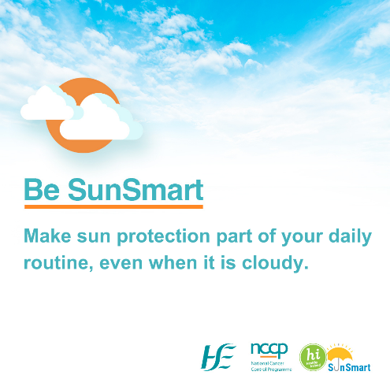
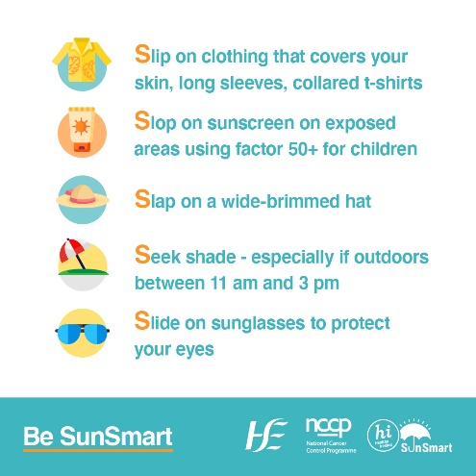
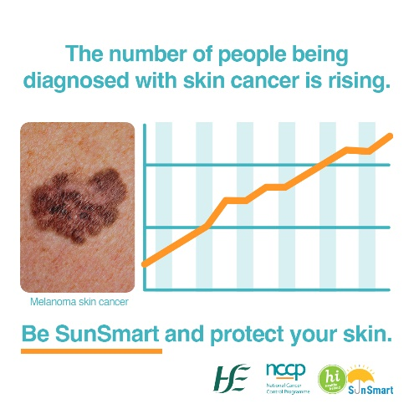
Sample social media posts for your use and social media assets - general
Please like and repost our messages. Right click on images to open the hyperlink of the social media images
Protecting your skin from the sun no matter where you are or why you are outdoors can reduce your risk of skin cancer. The best ways to protect your skin is to follow the #SunSmart 5 S’s – Slip, Slop, Slap, Seek and Slide. #SunSmart
Make sun protection part of your daily routine, especially from April to September even when it is cloudy. Be prepared, be #SunSmart
Skin cancer is the most common form of cancer in Ireland and the number of people being diagnosed with skin cancer is rising rapidly. Yet skin cancer is largely preventable by protecting skin from UV rays and not using sunbeds. #SunSmart

Slide 14
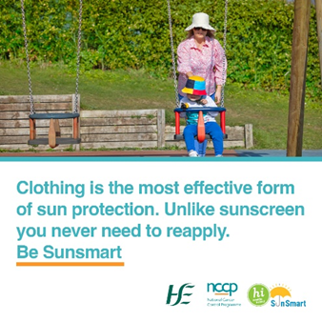
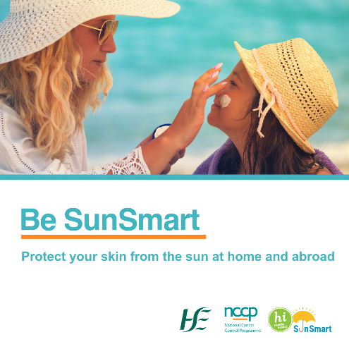
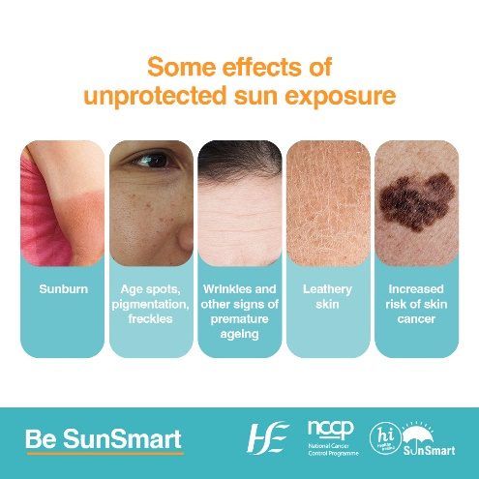
Sample social media posts for your use and social media assets – Children and teenagers
Please like and repost our messages. Right click on images to open the hyperlink of the social media images
Protect yourself and your family by being SunSmart as part your daily routine from April – September, even on cloudy days! In Ireland, UV from the sun is usually strongest between 11am to 3pm. #SunSmart
Whether your family is playing a game of football in the garden or enjoying a day at the beach, don’t forget the SunSmart 5 S’s to help keep your family safe from the sun’s UV rays. #SunSmart
Without sun protection you are leaving your skin exposed to UV radiation from the sun. This can cause sunburn, skin ageing such as wrinkles and age spots, eye damage and skin cancer.
Being active outside and having fun is great for children. However, when the UV index is 3 or above in Ireland remember to teach them protect their skin from UV rays #SunSmart #SlipSlopSlap#Seek#Slide

Slide 15
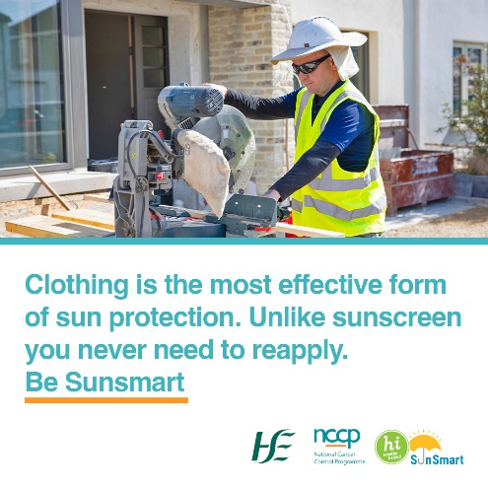
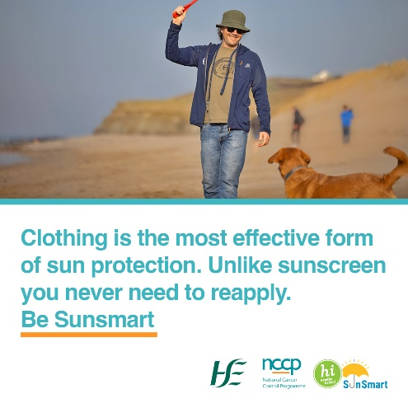
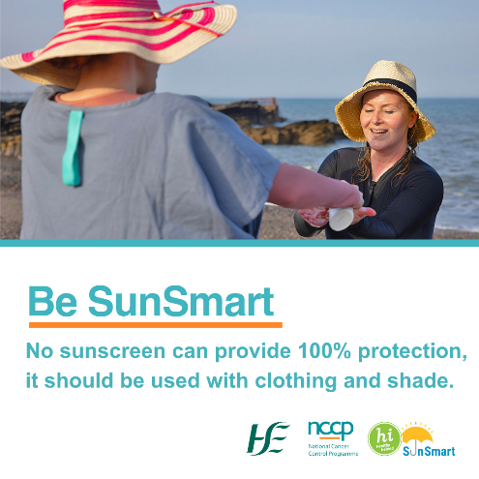
Sample social media posts for your use and social media assets – Outdoor workers and outdoor leisure
Please like and repost our messages. Right click on images to open the hyperlink of the social media images
Do you spend a lot of your working day outdoors? Farmers, construction workers, gardeners and other outdoor workers have a higher than average risk of skin cancer. Be prepared and be #SunSmart
Are you planning on being active outdoors today? Protect yourself by being SunSmart – Slip on clothing, Slop on sunscreen, Slap on a wide-brimmed hat, Seek shade and Slide on sunglasses. Even on cloudy days. #SunSmart
Spending time outdoors this weekend? Whether you are spending time at the beach, your garden or local park, protect your skin from UV radiation. #SunSmart

Slide 16
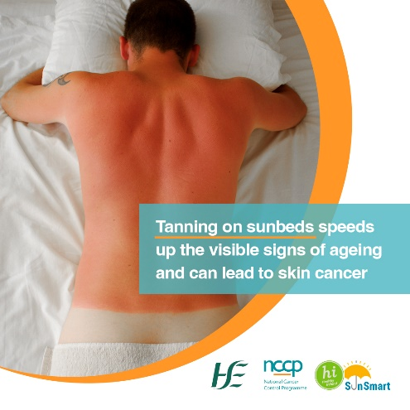
Sample social media posts for your use and social media assets – Sunbed users
Please like and repost our messages. Right click on images to open the hyperlink of the social media images
There is NO safe way to use a sunbed! Using sunbeds increases your risk of getting skin cancer. The earlier you start and the more often you use a sunbed, the greater the risk. #SunSmart
Using sunbeds has dangerous consequences. Sunbeds produce UV radiation causing premature skin ageing and increases your risk of skin cancer. #SunSmart
There is no such thing as a healthy suntan. A suntan is a sign that your skin is damaged by UV radiation from the sun or sunbeds. #SunSmart
Using sunbeds before the age of 35 increases the risk of melanoma, the most serious form of skin cancer by 75%. #SunSmart

Slide 17
4. Social media videos
Videos to watch and share on your social media channels:
Skin cancer prevention educational videos with Prof Tobin, dermatologist
How to reduce your risk of getting skin cancer?
What is skin cancer?
The dangers of using sunbeds and tanning injections
SunSmart videos on UV risk & skin protection for adolescents and young adults - Your skin cancer prevention questions answered
Does skin cancer only affect older adults?
Does getting a base tan from a sunbed prevent sun damage?
Do I really need sunscreen if my skin doesn't burn?
Do I need lots of sun to get Vitamin D?
There is no amount of sunbed use that is safe!

Slide 18
Contact information
Thank you for sharing this campaign.
For queries or ideas, please contact:
Maria McEnery, Cancer Prevention Officer, NCCP, prevention@cancercontrol.ie
Website: www.hse.ie/sunsmart

