Slide 1
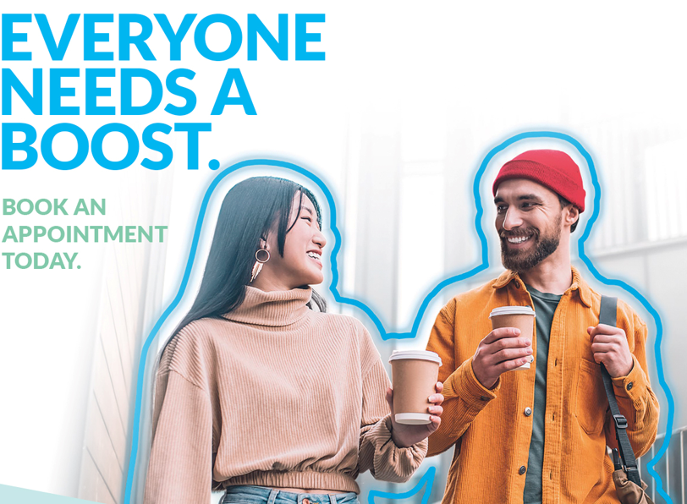
COVID-19 Vaccine Booster Dose
Partner Pack January 2022

Slide 2
COVID-19 Vaccine Booster Dose
You can get a booster dose now if you are 16 or older. Current research shows that 2 weeks after your booster, your protection against severe illness should go back up to 90%.
How long to wait before getting a booster
You need to wait 3 months (at least 90 days) after your first round of COVID-19 vaccination before you can get a booster.
If you had COVID-19 since you were vaccinated, you should get your booster dose at least 3 months after your positive test result.
How to get your booster
There are 3 ways to get your booster dose:
book a vaccination centre appointment
go to a walk-in booster clinic for your age group
book an appointment with a participating pharmacy
You may also be able to get your booster from your GP.
Weak immune system If you have a weak immune system you’ll need a booster dose three months after your last COVID-19 vaccine.
For most people this will mean your booster dose will be your fourth vaccine dose. An example of recommended COVID-19 vaccination for someone over 16 with a weak immune system is:
2 doses of the Pfizer vaccine as your first round of COVID-19 vaccination
an additional dose at least 2 months after this
a booster dose at least 3 months after your additional dose
If your first vaccine was COVID-19 vaccine Janssen, your booster will be your third vaccine dose.
An additional dose followed by a booster will hopefully give you better protection against COVID-19.

Slide 3
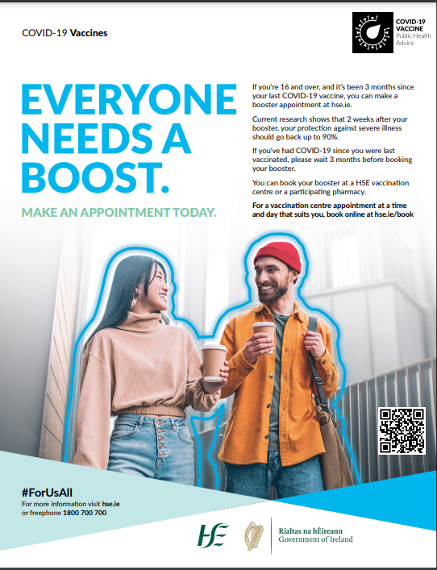
Media
Full page print ads ran in all national papers this week and local papers next week. The ad highlights the importance of taking up the booster dose of the COVID-19 vaccine when it is offered for the best protection again serious illness from COVID-19 for everyone aged 16 and over, even if you don’t have an underlying condition.
A radio ad reminding people that everyone aged 16 and over needs a booster dose of the COVID-19 vaccine to ensure the best possible protection against serious illness from COVID-19. You can listen to the radio ad here.

Slide 4
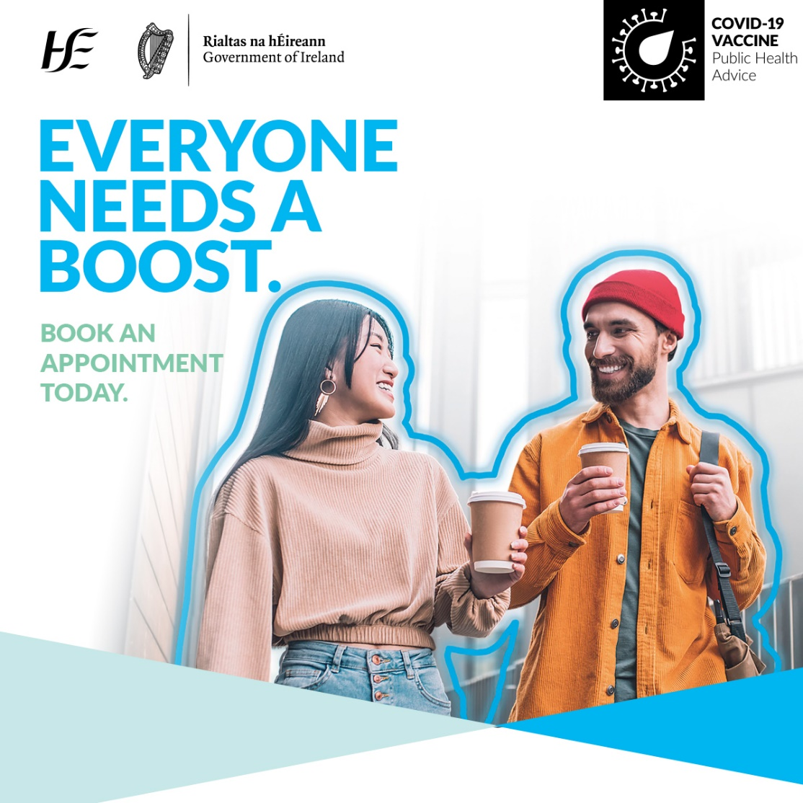
Social media
Sample message: Everyone 16+
If you're 16 and over can book your booster vaccine at a day and time that suits you on our website.
You can book three months after your last vaccine. If you've had COVID-19 since you were vaccinated, please wait three months.
Everyone needs a boost these days.#COVIDVaccines | #ForUsAll
More information: COVID-19 vaccine booster dose

Slide 5
Social media
Sample message: for people with a weak immune system
If you have a weak immune system you’ll need a booster dose three months after your last COVID-19 vaccine. For most people this will mean your booster dose will be your fourth vaccine dose. If your first vaccine was COVID-19 vaccine Janssen, your booster will be your third vaccine dose.
Learn more: https://www2.hse.ie/screening-and-vaccinations/covid-19-vaccine/get-the-vaccine/weak-immune-system/ #COVIDVaccines | #ForUsAll
More information: COVID-19 vaccine booster dose

Slide 6
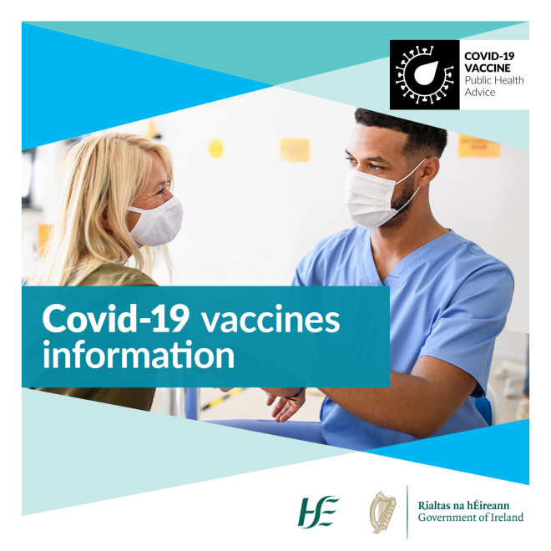
COVID-19 Vaccine Information
Clear information helps us all to make an informed decision about the vaccine.
You can find factual, updated information about COVID-19 Vaccine on www.hse.ie/covid19vaccine.
You can phone our team in HSELive on
1800 700 700.
You can email HSElive at hselive@hse.ie
Remote sign language interpretation can be arranged by appointment.
Go to our official social media channels for up to date news, videos, links and walk-in clinic details.
Downloadable information materials on the vaccines are available on www.hse.ie/covid19vaccinematerials
Vaccine information is available on this website in:
Over 24 languages, in both video and in information booklets.
Easy-Read format
Irish Sign Language
Audio, large print and braille

Slide 7
Please share with your networks
Thank you
#ForUsAll

