Slide 1
Proud and Prepared 2024 Partner Campaign Pack

Slide 2
Proud and Prepared 2024 Partner Campaign Pack
Proud and Prepared: A Community Collaboration
This 2024 Pride year, our focus is on spotlighting health and wellbeing to ensure everyone can be Proud and Prepared throughout the summer. To achieve this goal, we're launching the 'Proud and Prepared' initiative, a collaborative effort between LGBT community organisations like Gay Health Network & Man2Man.ie, BelongTo, LINC, Gay Men's Health Service (GMHS), and Dublin Pride.
Our mission is to raise awareness about available health and wellbeing services catering to various needs such as sexual health, mental health, physical health, and substance use support. Through our collective experience, we emphasise the important connection between a healthy body and mind, positively influencing every aspect of our lives.
For 2024 we are delighted to share proudandprepared.ie a resource with information on, and links to pages for sexual, mental and physical health, and drugs, alcohol and chemsex harm reduction.
We will run this creative throughout June and the rest of the Pride season.

Slide 3
Proud and Prepared 2024 Partner Campaign Pack
The beautiful Proud and Prepared creative was illustrated and designed by Colm Molloy https://colmmolloy.ie/. Nationwide OOH advertising commenced 13 June.
We will also put up posters and distribute leaflets in LGBT venues around Dublin.
OOH washroom posters
OOH Aviva Stadium (Pink and Taylor Swift)
2 page spread in GCN Pride Print edition
Ads at Mother Block Party
A5 leaflets for bars and venues and partner orgs
Vinyl banner(s) for Merrion Square
Stall and Screen in Community City in Merrion Square Pride village
Digital ads in LGBT venues
Digishelter ads in central Dublin
A3 Posters and A5 leaflets sent to Partner Organisations
Large display in Pride Hub, Clarendon Street
Instagram Reels with experts and influencers
Instagram carousels covering mental, sexual, and physical health, and drugs and chemsex harm reduction.
LED advertising screen at Pride Village
Pride Village: Tote bags with goodies, condoms, lube and harm reduction and sexual health information.

Slide 4
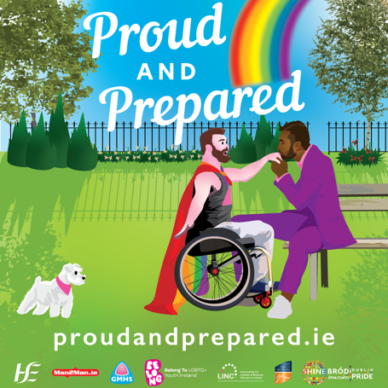
Proud and Prepared 2024 Partner Campaign Pack
We will also be going out with the campaign on Instagram and Facebook
Click (or copy and paste) the link below to gain access to the Proud and Prepared social media graphics and posters.
Instagram/Facebook/X square posts
Insta Stories
Health Carousels (Sexual, Mental, Physical, Drugs & Alcohol, Chemsex)
A3 poster and A5 leaflets
https://bit.ly/3Vylhm2
Please also feel free to share our Reels and Instagram carousels so that we can reach as wide an audience as possible. And if you are sharing stories please tag and link
@man2manireland
@belongtoyouthservices
@linc_ireland
@dublinpride

Slide 5
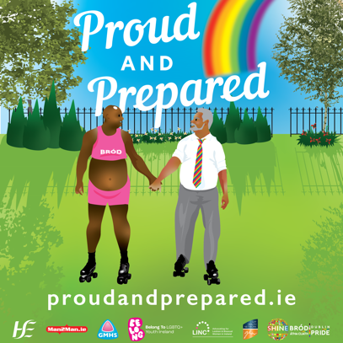
Proud and Prepared 2024 Partner Campaign Pack
Instagram Posts, (for Facebook remove the “Link in bio!”)
🌈 Proud and Prepared: A Community Collaboration 🌈
This Pride, we're putting health and well-being in the spotlight! Our 'Proud and Prepared' initiative brings together amazing LGBT community organisations like Gay Health Network & Man2Man.ie, BelongTo, LINC, Gay Men's Health Service (GMHS), and Dublin Pride. 💪🏳️‍🌈
We're here to raise awareness about health and wellbeing services tailored for our community, covering sexual health, mental health, physical health, and substance use support. Let's make this summer about being Proud and Prepared! 🌟
👉 Visit proudandprepared.ie to learn more. Link in bio!
#ProudAndPrepared #Pride2024 #LGBTHealth #CommunityCare #HealthAwareness #LoveIsLove #GMHS
Resources: https://bit.ly/3Vylhm2

Slide 6
Proud and Prepared 2024 Partner Campaign Pack
Instagram Posts, for Facebook remove the “Link in bio!”
🌟 Proud and Prepared: Health and Wellbeing for All 🌟
Join us in celebrating Pride by prioritising our health and wellbeing! The 'Proud and Prepared' initiative is a collaboration between LGBT organisations like Gay Health Network & Man2Man.ie, BelongTo, LINC, Gay Men's Health Service (GMHS), and Dublin Pride.
Our mission? To spotlight the vital health services available to our community, from sexual and mental health to physical wellness and substance use support. A healthy body and mind positively impact every part of our lives. 💖
Discover more at proudandprepared.ie. Link in bio!
#ProudAndPrepared #HealthAndWellbeing #PrideMonth #LGBTQCommunity #SupportAndCare
Resources: https://bit.ly/3Vylhm2

Slide 7
Proud and Prepared 2024 Partner Campaign Pack
Instagram Posts, for Facebook remove the “Link in bio!”
🌈 Celebrating Pride with Health and Community Support 🌈
This Pride, we're dedicated to highlighting health and well-being! Our 'Proud and Prepared' initiative unites fantastic LGBT organisations such as Gay Health Network & Man2Man.ie, BelongTo, LINC, Gay Men's Health Service (GMHS), and Dublin Pride.
We aim to raise awareness about comprehensive health services available to our community, including sexual health, mental health, physical wellness, and substance use support. Let's ensure we are all Proud and Prepared this summer! 🌈
Explore more at proudandprepared.ie. Link in bio!
#ProudAndPrepared #LGBTQHealth #PrideMonth #CommunityCollaboration #WellbeingMatters
Resources: https://bit.ly/3Vylhm2

Slide 8
Proud and Prepared 2024 Partner Campaign Pack
Twitter/X
Post 1
🌈 Proud and Prepared 🌈
This Pride, we're spotlighting health & well-being with GHN, Man2Man.ie, BelongTo, LINC, GMHS, & Dublin Pride. 💪🏳️‍🌈
Learn more at proudandprepared.ie
#ProudAndPrepared #Pride2024 #LGBTHealth #CommunityCare #LoveIsLove
Post 2
🌈 'Proud and Prepared': This Pride, spotlighting health & well-being with LGBT community orgs like Gay Health Network, BelongTo, LINC & more.
Information on sexual, mental, physical health & substance use.
Visit proudandprepared.ie
#ProudAndPrepared #Pride2024
Resources: https://bit.ly/3Vylhm2

Slide 9
Proud and Prepared 2024 Partner Campaign Pack
INSTAGRAMCAROUSELS

Slide 10
Proud and Prepared 2024 Partner Campaign Pack
Sexual Health Carousel
Message Copy
Sexual health is not just about avoiding or treating illness; it’s about feeling good in all aspects of your sexuality.
Our sexuality and sexual health are special gifts and worth taking care of and minding.
Swipe left to learn more
Visit proudandprepared.ie for more information and resources for your sexual and overall health.
#SexualHealth #Wellbeing #ProudAndPrepared #LGBTHealth #GetTested #KnowYourStatus
Resources: https://bit.ly/3Vylhm2

Slide 11
Proud and Prepared 2024 Partner Campaign Pack
Mental Health Carousel
Message Copy
As aptly stated by the World Health Organisation, "There is no health without mental health."
Our mental health and wellbeing are so important to every aspect of our lives.
Swipe left for more information about the resources available to you.
Visit proudandprepared.ie for more information and resources for your mental health.
#Wellbeing #MentalHealth #Wellbeing #ProudAndPrepared #LGBTHealth
Resources: https://bit.ly/3Vylhm2

Slide 12
Proud and Prepared 2024 Partner Campaign Pack
Let’s Get Physical Carousel
Message Copy
Staying physically active is one of the best ways to maintain good mental health. It is good for the body mind and soul.
Whether it's hitting the gym, running or walking, regular physical activity significantly enhances energy levels, mood, and sleep quality.
Swipe left for more info
Visit proudandprepared.ie for more information and resources for your health and wellbeing
#LGBT #LGBTHealth #GetActive #StayActive #ProudAndPrepared
Resources: https://bit.ly/3Vylhm2

Slide 13
Proud and Prepared 2024 Partner Campaign Pack
Drugs and Alcohol Carousel
Message Copy
While it is safer not to use drugs, if you do, the best advice is to start low, go slow and leave the mixing to the DJs.
This Pride, take care to mind yourself and look out for others!
Swipe left for more info on safe habits when enjoying the party.
Visit proudandprepared.ie for more information and resources on drugs and alcohol.
#Drugs #Alcohol #Pride #StartLowGoSlow #ProudAndPrepared
Resources: https://bit.ly/3Vylhm2

Slide 14
Proud and Prepared 2024 Partner Campaign Pack
Chemsex Carousel
Message Copy
Chemsex, using drugs for sex, is getting more common. The best way to stay safe is to learn about it to keep ourselves and others safe.
Swipe left for more information on where you can find resources related to Chemsex and stay safe this pride season.
Visit proudandprepared.ie for more information and resources for your health and wellbeing.
#Chemsex #Pride #StartLowGoSlow #ProudAndPrepared #SexPartyFirstAid
Resources: https://bit.ly/3Vylhm2

Slide 15
Proud and Prepared 2024 Partner Campaign Pack
Contact Details
Pádraig Burke | Comms Director, GHN | 087 0573625 | padraig@ghn.ie
Brenda Kelly | Senior Youth Worker BelongTo | Brenda@belongto.org
Kate Moynihan | Coordinator, LINC | kate@linc.ie
Jamie Kenny | Co Ceo, Dublin LGBTQ+ Pride | 085 1549589 | jamie@dublinpride.ie
Muireann Kirby | HSE Programmes and Campaigns | muireann.kirby@hse.ie

