Slide 1
COVID-19 Vaccine Booster Dose
Partner Pack
November 2021

Slide 2
COVID-19 Vaccine Booster Dose
Booster doses of the COVID-19 vaccine are currently being offered to:
Everyone aged 60 and over
Healthcare workers
Why some people need a booster vaccine
All COVID-19 vaccines licensed in Ireland are effective at protecting you against hospitalisation and severe illness from COVID-19. However, protection may reduce over time, and infections and illness in people who are fully vaccinated can still happen.
How you will get a booster If you are aged 70 or over, you'll be invited for your vaccine by your GP. Some GPs will refer patients to a vaccination centre.
If you are aged 60 to 69, you will get a text message from the HSE with a vaccination centre appointment.
If you’re in any of the groups currently being offered boosters, you can also go to a booster walk-in clinic, or you can go to a participating pharmacy.
Which vaccine you will be offered
Regardless of which COVID-19 vaccine course you had previously:
People aged 30 and over will be offered a single booster dose of either the Pfizer/BioNTech COVID-19 vaccine or Moderna COVID-19 vaccine.
People aged 29 and under will be offered a single booster dose of the Pfizer/BioNTech COVID-19 vaccine.
More information: COVID-19 Vaccine Booster Dose

Slide 3
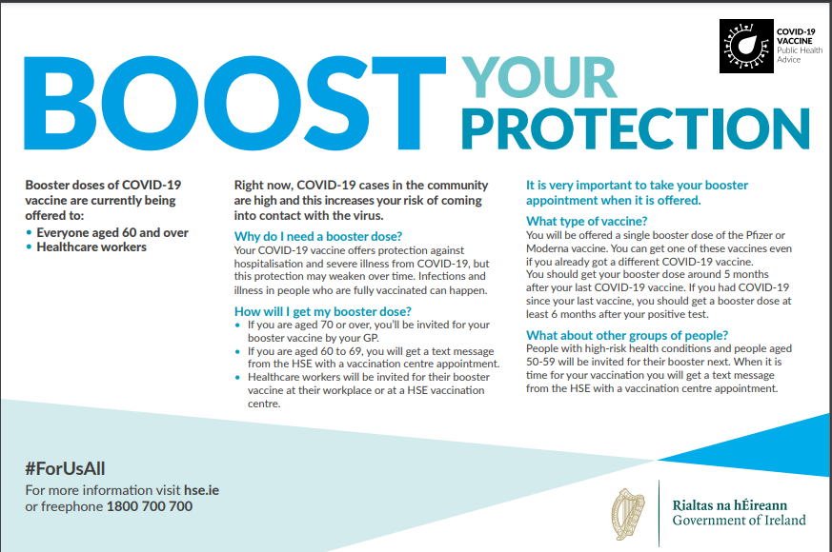
Media
Full page print ads ran in all national papers last week and local papers next week. The ad highlights the importance of taking up the booster dose of the COVID-19 vaccine when it is offered for the best protection again serious illness from COVID-19. Out of home advertising with the same messages also started this week. This will be seen on posters and digital screen in shopping and commuting areas, and on buses.
A radio ad targeting people aged 60-69, who are now eligible for a booster vaccine is currently on air. You can listen to the radio ad here.

Slide 4
Social media
Sample message:
Booster doses of COVID-19 vaccine are currently being offered to everyone aged 60+ and healthcare workers. The protection from your COVID-19 vaccine against severe illness from COVID-19 may weaken over time. The booster dose is recommended at least 5 months after your last vaccine, to give you the best possible protection. Please take up your booster appointment when it's offered. Find out more here: https://bit.ly/3kRKMNE #COVIDVaccines #ForUsAll
More information: COVID-19 vaccine booster dose

Slide 5
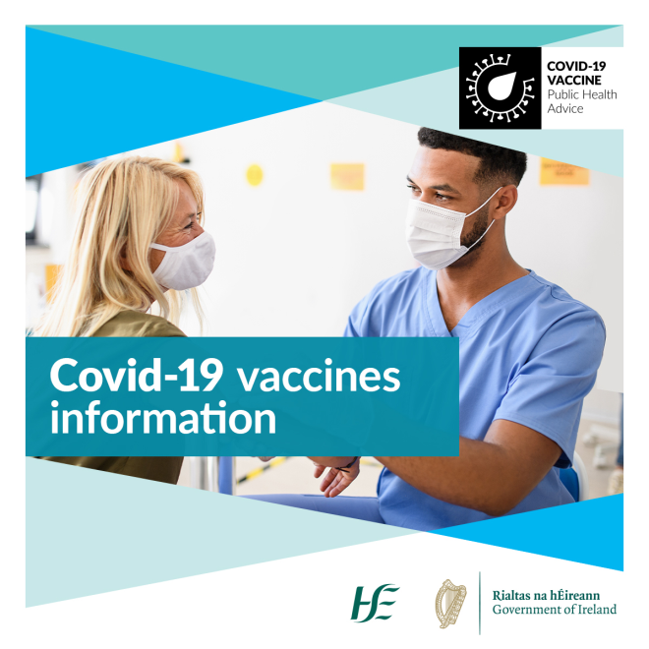
COVID-19 Vaccine Information
Clear information helps us all to make an informed decision about the vaccine.
You can find factual, updated information about COVID-19 Vaccine on www.hse.ie/covid19vaccine.
You can phone our team in HSELive on
1800 700 700.
You can email HSElive at hselive@hse.ie
Remote sign language interpretation can be arranged by appointment.
Go to our official social media channels for up to date news, videos, links and walk-in clinic details.
Downloadable information materials on the vaccines are available on www.hse.ie/covid19vaccinematerials
Vaccine information is available on this website in:
Over 24 languages, in both video and in information booklets.
Easy-Read format
Irish Sign Language
Audio, large print and braille

Slide 6
Please share with your networks
Thank you

