Slide 1
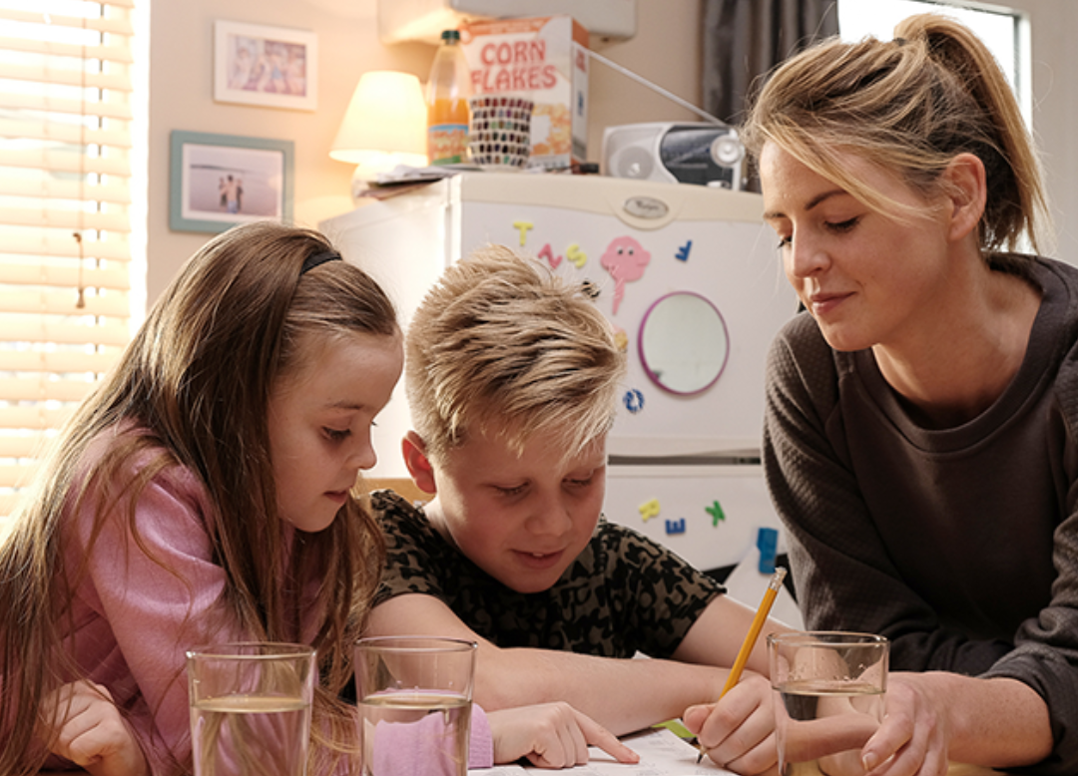
START campaign:
One daily win
Partner pack
January 2023
www.makeastart.ie

Slide 2
Background and context
The START campaign is back on TV, radio, cinema and online throughout January.
While reducing treats is as important as ever, you’ll see the one daily win TV ad this time, offering families more healthy habit options.
Radio ads will feature Sarah swapping sugary breakfast cereal for a healthy one, and Steven introducing vegetables to dinner time.
Parents and guardians can find lots of tips and advice for one daily win at www.makeastart.ie

Slide 3
Key messages
Choose one area to change and start small. Be realistic about what your family can do.
Think of a goal and then make a plan on how you’d like to achieve it.
For example you could:
Change from sugary breakfast cereal to wholemeal breakfast cereal on weekdays
Drink water with dinner instead of sugary drinks
Have fruit after school instead of treats
Make a healthy meal plan for weekdays

Slide 4
Sharing with your networks
Website: signpost your network to www.makeastart.ie
Highlights:
Healthy eating
Swapping sugary drinks for milk or water
Plan for healthier meals
Your newsletter: publish an article on START
Publications: order START information leaflets and posters – select ‘healthy eating’ or search ‘START’
Events: if you’d like to run a small event or activity, we’ll give you everything you need

Slide 5
Social media resources
FB/IG @safefood.net TW @safefood_net
www.makeastart.ie #makeastart
Sample posts:
Twitter | Start by changing one thing, not everything. For ways to make one daily win visit www.makeastart.ie
Facebook or Instagram | Swaps are a great way to start, like fruit after school. For more ways to make one daily win visit www.makeastart.ie
Facebook or Instagram | Start by keeping fruit where the kids can reach it. For more ways to make one daily win visit www.makeastart.ie

Slide 6
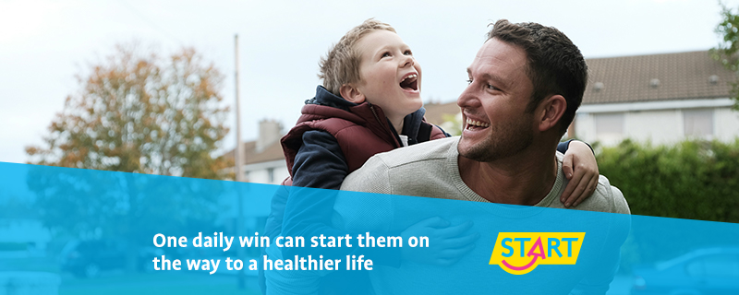
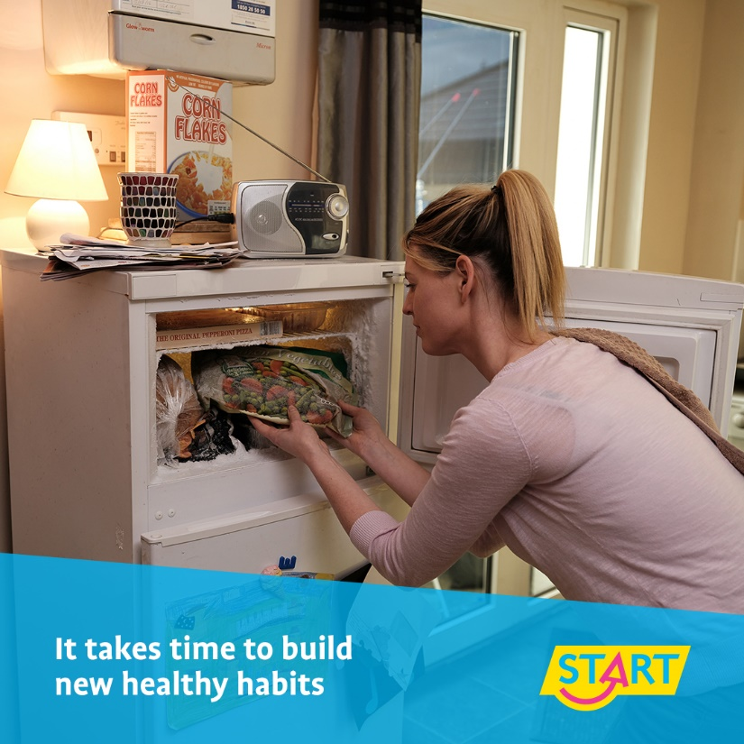
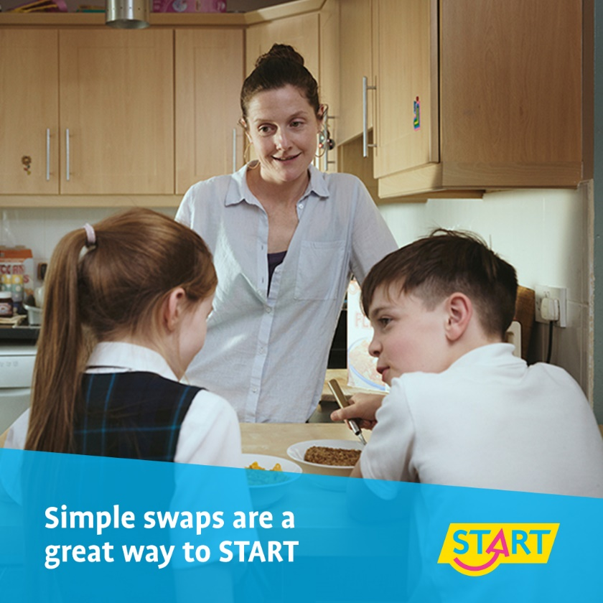
Twitter
FB/IG

Slide 7
Thank you
For more information, please contact:
Orlaith Potter, Programmes and Campaigns, Communications Division, HSE Email: orlaith.potter@hse.ie
Eamon Keogh, Communications, Health and Wellbeing, HSE Email: eamon.keogh1@hse.ie
Thank you for supporting the campaign.

