Slide 1
Dementia: Understand Together in Communities
Launch of new inclusive community symbol

Slide 2
Dementia: Understand Together in Communities
The Dementia: Understand Together campaign is led by the HSE, working with the Alzheimer Society of Ireland (ASI), Age Friendly Ireland, the Dementia Services Information and Development Centre, Age & Opportunity and Healthy Ireland.
In Ireland, there are over 64,000 people living with dementia and this number is set to increase which means more and more of us will be affected by dementia in our lifetime. With 63% of people with dementia living within their community, dementia is not just a health but a social issue that needs a community response.
Our vision is to help create an Ireland that embraces and includes people living with dementia, and displays solidarity with them and their families.
The campaign is supported by over 40 partner organisations across Ireland ranging from retail, transport, banking, health, voluntary and community sectors who, together with over 500 community champions are leading the way in creating inclusive communities.

Slide 3
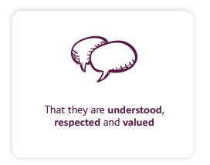
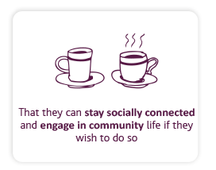
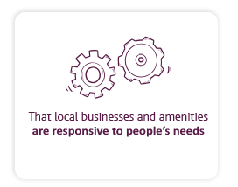
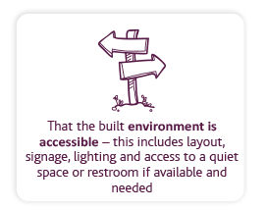
What matters most to people living with dementia
There are 4 key outcomes that people with dementia and their families say matter to them
These outcomes are at the core of helping us to build dementia inclusive communities.

Slide 4
Launch of the new Dementia Inclusive Community symbol

Slide 5
Why now?
500+ champions taking action
We have the opportunity to connect all that is happening across the country and visually represent the culture change we are seeing with the launch of our dementia inclusive symbol.
Our ambition is that the symbol will:
increase visibility and awareness of the Dementia: Understand Together campaign
act as an overarching symbol of solidarity, inclusivity and support for people living with dementia
be a sign that communities, businesses and services are working towards being dementia inclusive
57,000+ followers on Facebook
40 national partner organisations
“I think it’s going to be a game changer! It’s taking things to a whole new level”
(person living with dementia)

Slide 6
Why does this matter?
We want to send a strong message that people with dementia and their families are valued and respected members of our communities.
Health and wellbeing is closely linked to the social engagement we have in our communities, many studies, anecdotal stories and our experiences of the last years during a pandemic speak to this.
Social isolation is often more likely for a person with dementia and staying socially active and engaged can help in many ways. As well as slowing the progression of dementia, it can positively affect mood and a person’s overall health and wellbeing.
By raising awareness of dementia in our communities and actively supporting people to understand how they can make a difference, we can give people with dementia the confidence to retain some of their independence and routine where appropriate, be that attending appointments, using their bank or traveling by public transport.
It also opens up opportunities for people to keep up activities and hobbies, whether someone wants to meet a friend for coffee or make a visit to the Museum of Modern Art (IMMA) for example. We want people with dementia to feel able to get involved and join in with groups such as the Men’s Sheds, Dementia Cafés and more.

Slide 7
Who did we speak to when developing the symbol?
Partners and champions took part in online engagement sessions.
People with dementia took part in online and in person engagement sessions facilitated by the Alzheimer's Society of Ireland (ASI).
Members of the public gave feedback at the National Ploughing Championships.
The Dementia: Understand Together working group members were actively involved including a member living with dementia and two carers
Developed with people living with dementia at its heart.

Slide 8
Get involved

Slide 9
How are we rolling out the symbol?
200+ conversations with national partners
Local launches in discussion within 7 counties
Partners and champions are pledging to display the symbol to show their commitment to becoming dementia inclusive.
The symbol will be displayed on shop fronts, websites, newsletters, social media and more.
Many have rolled out training with their staff or are planning to this year. Others have specific initiatives that we will support.
Briefing sessions have taken place with Community Champions, Dementia Advisors, Memory Technology Resource Room Coordinators and ASI helpline and information and advice staff

Slide 10
How are we launching the symbol?
National and local press releases
Dementia Inclusive Community toolkits created and available to order online
A national media campaign will run from 27th March-9th April.
Print and digital advertising will be shared across the National Transport Authority and Iarnród Éireann networks, at bus shelters, shopping centres and on social media.
A short video clip promoting the symbol will be shown on Virgin Media for one week.
Minister Butler will officially launch the symbol on 28th March at a celebration event in Smock Alley Theatre led by people with dementia and Community Champions

Slide 11
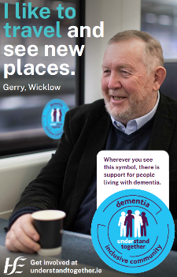
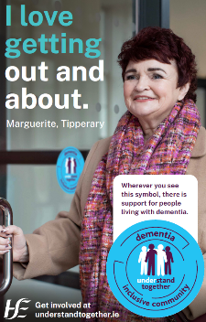
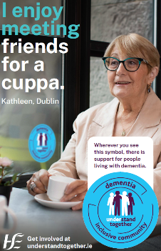
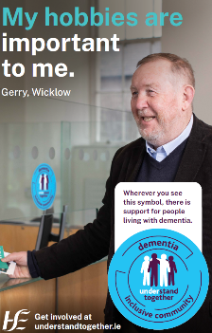
Gerry, Marguerite and Kathleen – the people of our campaign
Notes:
Update with final adverts

Slide 12
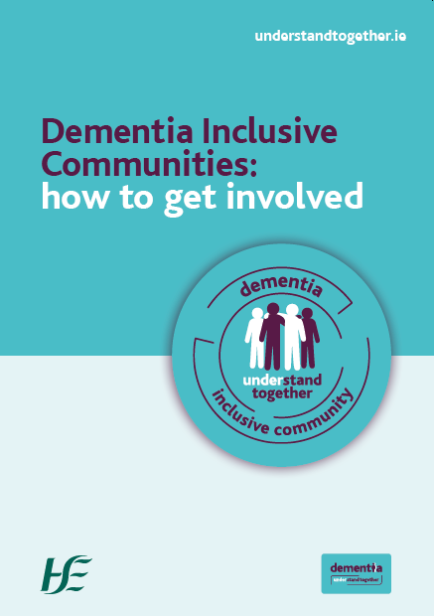
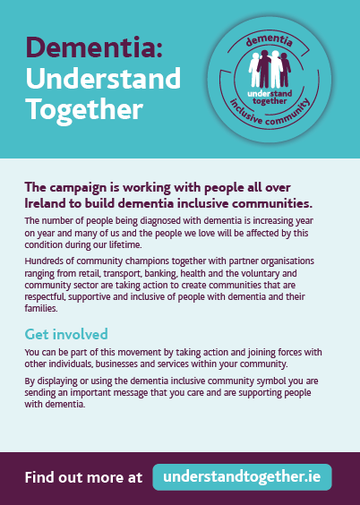
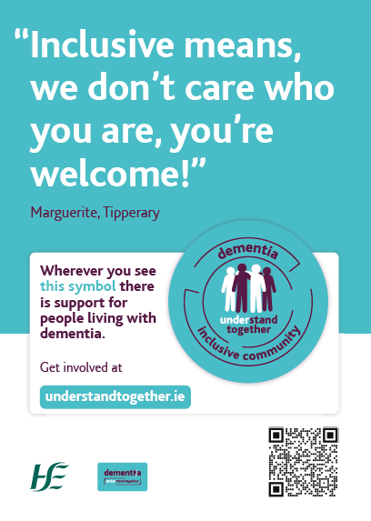
Your Dementia Inclusive Community toolkit
Your dementia inclusive community toolkit includes:
How to get involved guidance
Leaflets
Posters
Window/Glass stickers – symbol
Badges
Toolkits are being distributed to partners and champions
Individual items will be available to order on healthpromotion.ie
You can register at understandtogether.ie
Request additional support by contacting understandtogether@hse.ie
Notes:
Add higher res options, we page, folder

Slide 13
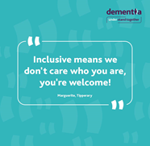
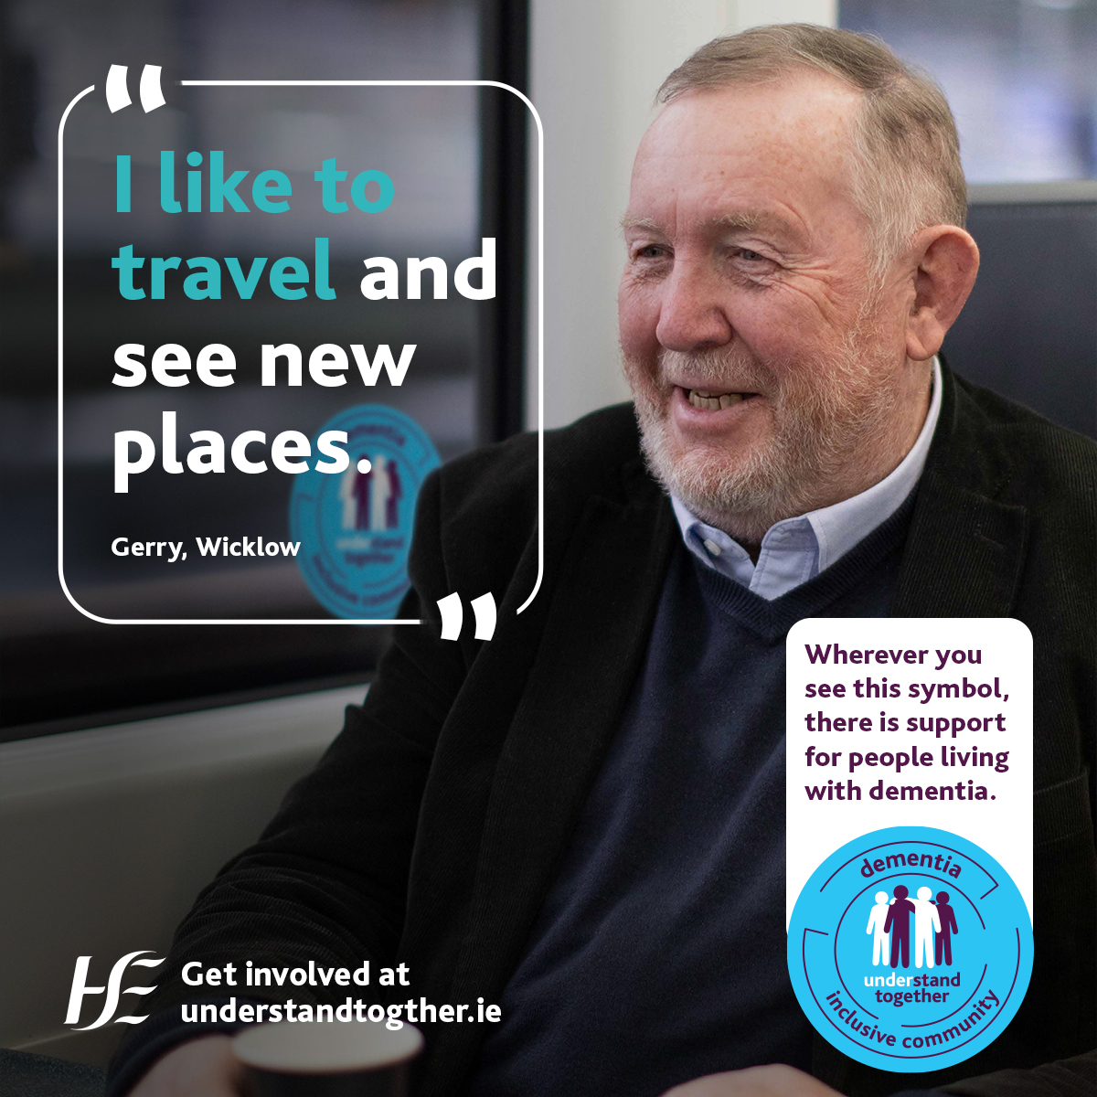
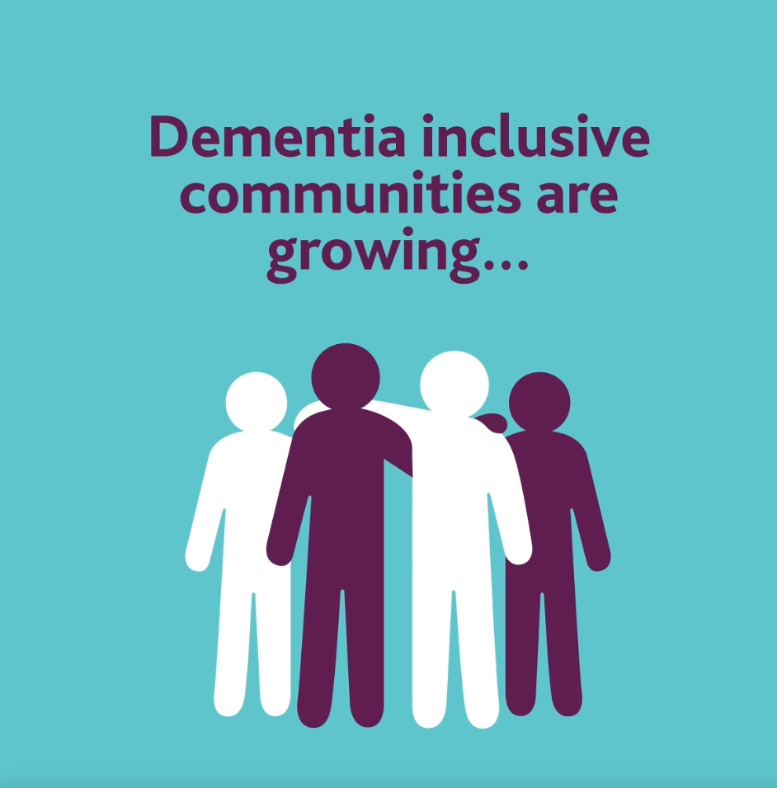
Growing the Dementia Inclusive Community
We need our partners, champions and supporters to help us spread the word so that the dementia inclusive community symbol can be seen across every parish, village, town and city in Ireland.
As well as ordering your dementia inclusive community toolkit and signing up to get involved, we’d be grateful if you could help by sharing our messages on your channels including social media.
We’ve produced some editable templates to help you, including:
Facebook and Twitter posts
Images
Videos
Website copy
Newsletter copy
Some of these templates are included in the next slides, you can request additional files and get further support for promotion, including jointly branded templates by contacting understandtogether@hse.ie
Notes:
Add higher res options, we page, folder

Slide 14
Social media templates
Date | Post |  | Image/Video
 | Facebook/LinkedIn | Twitter
Pre 26 March | We can't wait to share some really exciting news with you next week! Stay tuned for updates and if you haven't already, why not sign up to become a community champion and be part of something special coming soon at: www.understandtogether.ie/get-involved #UnderstandTogether #DementiaInclusiveCommunities #ComingSoon | We can't wait to share some really exciting news with you next week! Stay tuned for updates, you can sign up to become a community champion and be part of something special coming soon at: www.understandtogether.ie/get-involved #UnderstandTogether #DementiaInclusiveCommunities
Pre 26 March | We can all help to create dementia inclusive communities by raising awareness and showing solidarity with people living with dementia, their families and friends. Something very special is launching next Tuesday that will support us all to make a difference. For more information or to get involved, visit: ENTER YOUR OWN WEBSITE ADDRESS or use www.understandtogether.ie/get-involved (edit/delete as needed) #UnderstandTogether #DementiaInclusiveCommunities #ComingSoon | We can all help to create dementia inclusive communities by raising awareness. Something very special is launching next Tues that will support us all to make a difference. For more information or to get involved, visit: ENTER YOUR OWN WEBSITE ADDRESS or use www.understandtogether.ie/get-involved (edit/delete as needed)
Notes:
Add higher res options, we page, folder

Slide 15
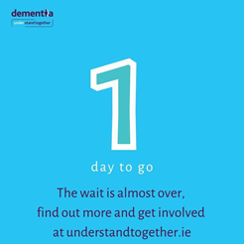
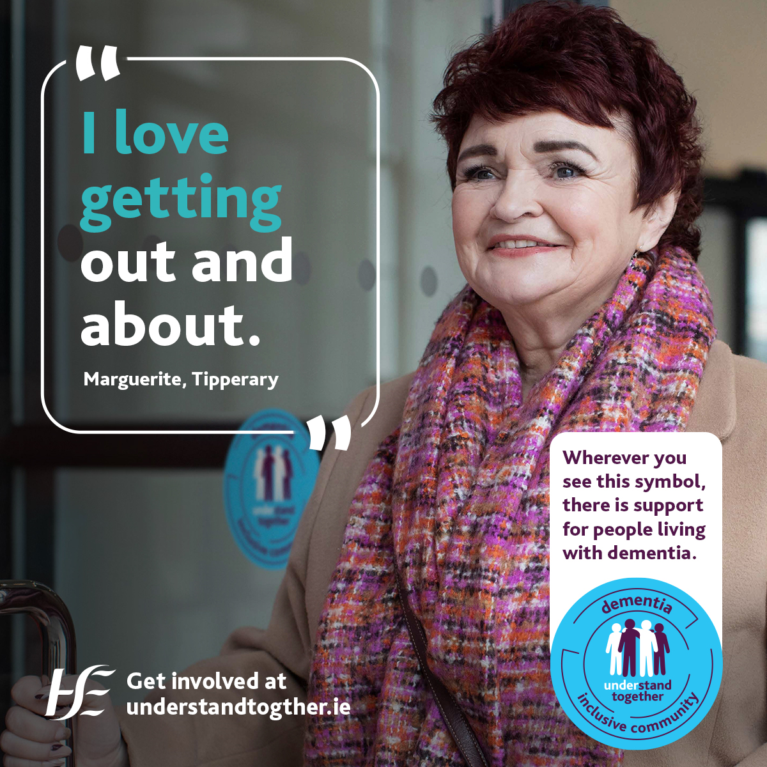
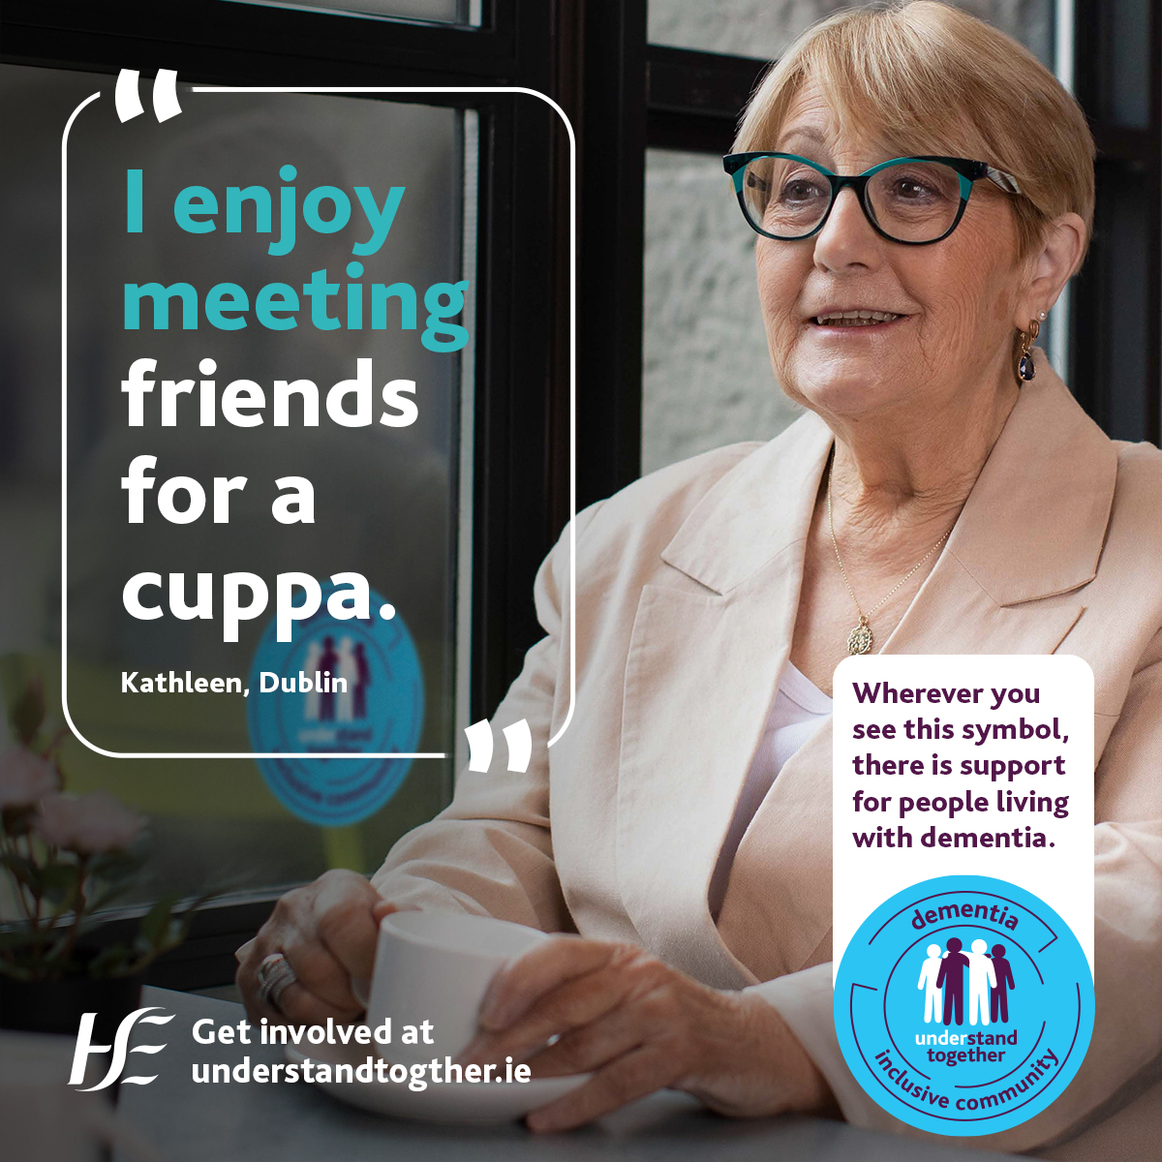
Social media accounts to tag
Date | Post |  | Image/Video
 | Facebook/LinkedIn | Twitter
27 March | 1 day to go...the wait is almost over, find out more and get involved at: understandtogether.ie #UnderstandTogether #DementiaInclusiveCommunities #ComingSoon | 1 day to go...the wait is almost over, find out more and get involved at: understandtogether.ie #UnderstandTogether #DementiaInclusiveCommunities #ComingSoon
Please do not post until after 1.30pm 28 March | We're delighted to be part of the dementia inclusive community! Today a new community symbol has been launched nationally to raise awareness and show support for people living with dementia, their families and friends. Wherever you see this symbol there is support for people with dementia. We’re proud to be a partner of the campaign and have committed to work with our staff/volunteers/customers (edit/delete as needed) to make our service/organisation (edit/delete as needed) as dementia inclusive as possible. To find out more and get involved, visit ENTER YOUR OWN WEBSITE ADDRESS or use www.understandtogether.ie/get-involved (edit/delete as needed) #UnderstandTogether #Welcome #DementiaInclusiveCommunities | We're delighted to be part of the dementia inclusive community! This new symbol will raise awareness and show support for people with dementia. We’ve committed to work with our staff/volunteers/customers (edit/delete as needed) to make our service/organisation (edit/delete as needed) as inclusive as possible. To find out more, visit ENTER YOUR OWN WEBSITE ADDRESS or use www.understandtogether.ie/get-involved (edit/delete as needed) #UnderstandTogether
Notes:
Add higher res options, we page, folder

Slide 16
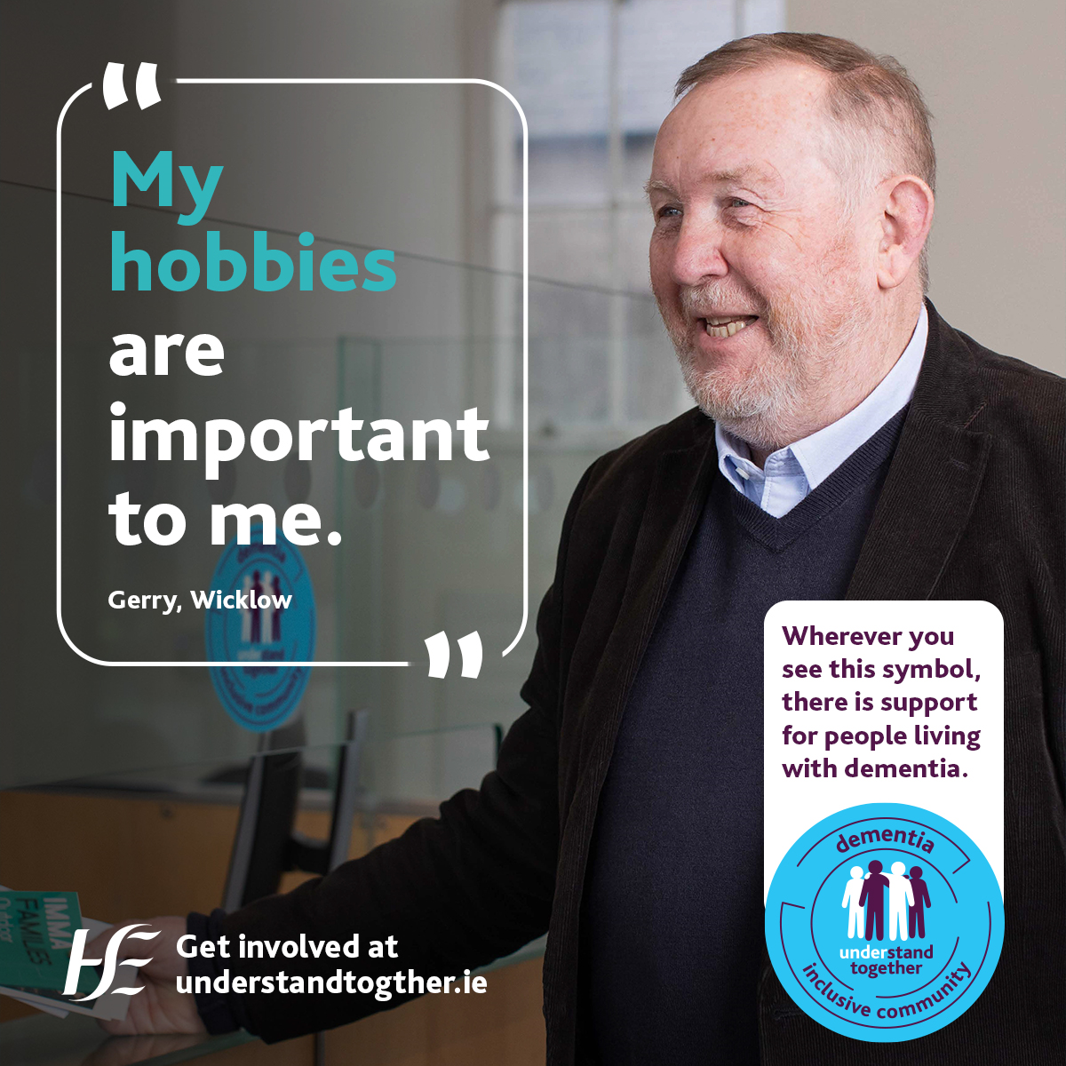
Social media accounts to tag
Date | Post |  | Image/Video
 | Facebook/LinkedIn | Twitter
Please do not post until after 1.30pm 28 March | Today we attended the launch of a new national dementia inclusive community symbol with Mary Butler TD, Minister of State with responsibility for Mental Health and Older People The celebration event was led by people with dementia and by champions working to create dementia inclusive communities on the ground. The symbol - which is to be used by people and organisations on shop fronts, windows, websites, newsletters and social media – will help to raise awareness and shows a commitment that we are working to become as dementia inclusive as possible. By #understandingtogether we can make a difference and support people with dementia in our communities to stay connected and included. For more information about how INSERT ORG NAME are supporting, visit: ENTER YOUR OWN WEBSITE ADDRESS or use www.understandtogether.ie/get-involved (edit/delete as needed) #Welcome #DementiaInclusiveCommunities | Today @MaryButlerTD launched a new national dementia inclusive community symbol. By #understandingtogether we can make a difference and support people with dementia in our communities to stay connected and included. For more information about how INSERT ORG NAME are supporting, visit: ENTER YOUR OWN WEBSITE ADDRESS or use www.understandtogether.ie/get-involved (edit/delete as needed) #Welcome #DementiaInclusiveCommunities | Selection of event photos
Post any time after March | We’re proud to be a part of the Dementia Inclusive Community. This new community symbol has been developed with people living with dementia at its heart. We’re using the symbol to show that we stand together with people with dementia and their families and friends. We’re committed to working together with our staff/volunteers/customers (delete as needed) to make our service as inclusive as possible. Wherever you see this symbol there is support for people with dementia. #UnderstandTogether #DementiaInclusiveCommunities | We’re proud to be a part of the Dementia Inclusive Community. This new symbol has been developed with people living with dementia at its heart. We’re using the symbol to show that we stand together with people with dementia. We’re committed to working together with our staff/volunteers/customers (delete as needed) to make our service as inclusive as possible. #UnderstandTogether #DementiaInclusiveCommunities
Notes:
Add higher res options, we page, folder

Slide 17
Social media accounts to tag
Dementia: Understand Together partners can be tagged to help amplify your posts:
Organisation | Twitter | Facebook
Dementia: Understand Together campaign official accounts | @dementia_office | @dementiaunderstandtogether
Alzheimer Society of Ireland (ASI), | @alzheimersocirl | @TheAlzheimerSocietyofIreland
Age Friendly Ireland | @AgeFriendlyIrl | @AgeFriendlyIrl
Dementia Services Information and Development Centre | @DSIDCDementia | @DementiaDSIDC
Age & Opportunity | @Age_Opp | @AgeandOpportunity
Healthy Ireland | @HealthyIreland | @healthyireland.gov.ie
HSE | @hselive | @HSElive
Notes:
Add higher res options, we page, folder

Slide 18
For more information contact:
Fiona Foley, National Dementia Office fiona.foley1@hse.ie
Aine Hutcherson, HSE Communications Aine.Hutcherson@hse.ie
Roisin Guiry, HSE Communications roisin.guiry@hse.ie
“I would be very slow to ask for help when out and about but if I saw that sign on the door I’d have no problem in asking”
(person living with dementia)

