Slide 1
Launch of HSE Free National Home STI Testing Service
Partner Pack
7 October 2022

Slide 2
Launch of a free national home STI testing service
The HSE Sexual Health and Crisis Pregnancy Programme (SHCPP), Health and Wellbeing, launched a free national STI testing service which provides people living in Ireland aged 17 and older, the option to test for STIs at home.
Following an EU tender procurement process, the national contract was awarded to online provider Sexual Health 24 (SH:24) and commenced 1st May 2022. The service has now been expanded to all 26 counties in the Republic of Ireland.
Full details, including how to order a free home STI test is available on www.sexualwellbeing.ie

Slide 3
The free national home STI testing service
The HSE free home STI testing service is available to anyone aged 17 or older who lives in the Republic of Ireland.
Individuals can:
order a home test kit online
return your samples to the lab by post
get your test results by text message or phone call
Home STI testing is generally for individuals who do not have symptoms of an STI.
Individuals who have symptoms of an STI or need urgent support, should contact their local STI clinic or GP.

Slide 4
STIs the kits test for
The home test kits test for:
chlamydia
gonorrhoea
HIV
syphilis
Some individuals may get a test for hepatitis B or hepatitis C.
12345

Slide 5
Ordering a test kit online
The HSE is delivering this service in partnership with online provider SH:24:
Individuals can order a test kit at sh24.ie.
There are daily caps in place, so individuals are advised if no kits are available that day, to try again the next morning.
Individuals will get a text message once their kit has been sent.
12345

Slide 6
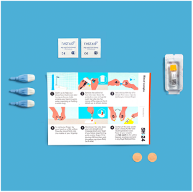
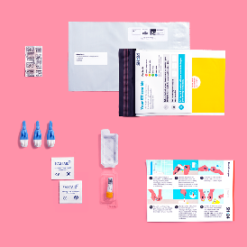
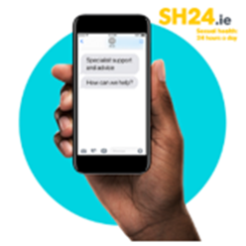
Taking the samples
The test kit will include:
all the equipment service users need to collect the samples
instructions and links to videos on how to take the samples
Individuals are advised if they have any problems, to reply to any text from SH:24 and ask for help. This is provided by a member of the clinical team.
12345

Slide 7
Returning the samples
Service users get a stamped addressed envelope with their test kit. This should be used to post the samples back to the lab.
Service users will get a text message when the lab gets their samples.
If there is a problem with any of the samples (for example, if one is damaged), service users will be sent another test kit.
12345

Slide 8
Test results
All results are negative – individuals will get a text message with the results.
Positive result for chlamydia or gonorrhoea - individuals will get a text message that shows the result and explains how to get free care and treatment from an STI clinic.
Reactive blood result (it is highlighted that a reactive blood result doesn’t always mean a positive result)
for syphilis – individuals will get a text message with the results
for hepatitis B, hepatitis C or HIV - individuals will get a phone call with the results.
It is explained to individuals that the result needs to be checked with a blood test taken by a healthcare provider and that the SH:24 clinical team refer them to a public STI clinic for assessment and testing.
12345

Slide 9
Contact
SH:24 have a clinical team who are responsible for results management and referral pathways for all users of this service.
Individuals can contact the service by replying to any of the text messages they receive from SH:24.
12345

Slide 10
New creative assets for the home testing service
A new ‘street art’ style creative designed by Joe Caslin will be delivered as part of the launch of the national service.
The aim of the campaign is to:
Raise awareness of the national service
Emphasise the role of STI testing within the overall context of STI prevention and treatment for individuals.
Direct the public to Sexualwellbeing.ie to order a free home STI test kit and to learn more
OOH advertising will start on 10th October for two weeks. A second burst will be promoted in November.
The campaign will be promoted through busy city centre orb screens in social areas, pub and club washrooms and College washrooms and screens.
Digital and Social media advertising is currently live.

Slide 11
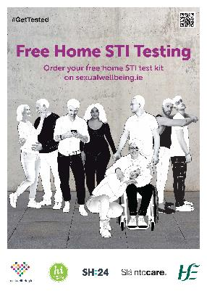
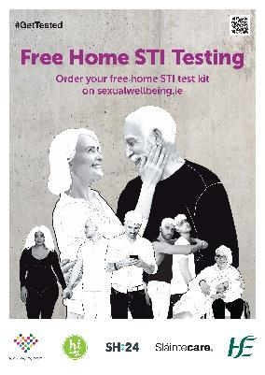
New Posters and business cards to promote the service
New posters and business cards are available to download now or to order directly from HealthPromotion.ie
Web posters available to download:
A3 and A4 web versions of poster available to download here
For professional printing: A3 and A4 versions of poster artwork (with bleed for printing) available to download here and business cards available here.

Slide 12
Digital advertising and Search
Digital display advertising will be optimised towards meeting the 18-30 year old audience.
Digital display advertising will also appear on dating apps (including Tinder and Grindr during the month of October 2022)
Social media videos and messages will be promoted across SWB social media platforms.
We will continue to use Google search advertising to promote free home STI testing and to direct people to the Sexual Wellbeing website.

Slide 13
Supporting the campaign
Social media messages will be delivered through Sexual Wellbeing’s social media platforms.
You can support the launch of this new service by sharing our messages as they appear on Twitter, Facebook, Instagram and Tiktok.
Tag the Sexual Wellbeing social media accounts and use a hashtag #GetTested or #SexualWellbeing so that we can share and like your post.
You can also support by sharing this Partner Pack with others who may be interested..
You can find the messages here:
Twitter: @_respectprotect
Facebook: @Sexual Wellbeing
Instagram: @hserespectprotect
Tiktok: @sexualwellbeing.ie
Website: sexualwellbeing.ie/hometesting

Slide 14
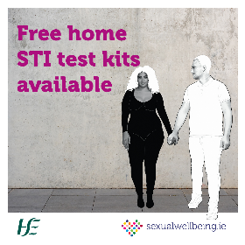
Social media messaging – sample copy
A full range of social media images in different sizes is available to download here.
Free home STI testing is now available for anyone aged 17 and over in Ireland.
To find out more, or to order your free home STI test kit visit: sexualwellbeing.ie/hometesting
#SexualWellbeing #GetTested
Free home STI testing is now available for anyone aged 17 and over living in the republic of Ireland.
For more information and to order a kit, visit: sexualwellbeing.ie/hometesting
#SexualWellbeing #GetTested

Slide 15
Social media partnership with University of Galway
Videos recorded with University of Galway Students Union will be promoted on Sexual Wellbeing social media platforms, for the 18-30 year old audience.
The videos are narrated by University of Galway’s Student Welfare Officer Imogen O’Flaherty.
The videos aim to:
Promote availability of the home testing service
Explain more about the test kit and how it works
Educate and inform about STIs and broader sexual health, including promotion of sexualwellbeing.ie
Videos are also available to view here: Intro video, Unpacking video, STI FAQs, Top Reasons to Get Tested, What’s in the Pack, Guessing Game.

Slide 16
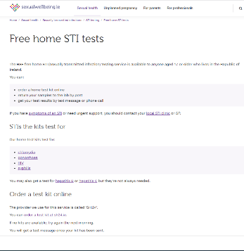
Information
Information about the free national home STI testing service and how to order a test kit, is available on sexualwellbeing.ie/hometesting

Slide 17
HSE campaign contacts
HSE Project Manager: Caroline Hurley caroline.hurley1@hse.ie
Communications Lead: Anita Ghafoor-Butt anita.butt@hse.ie
087 350 1587.
Campaign Manager: Muireann Kirby muireann.kirby@hse.ie
Social Media Lead: Peter Dineen
HSE Press Office: press@hse.ie

