Slide 1
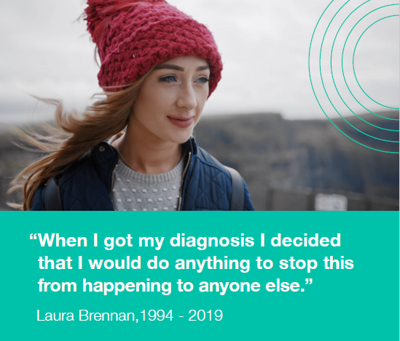
Slide Templates
For HSE and Funded Agencies
Laura Brennan HPV Vaccine Catch Up Programme Campaign Partner Pack Feb 2023

Slide 2
Laura Brennan HPV Vaccine Catch Up Programme
The Laura Brennan HPV vaccine catch-up programme is for some people age 16 or older who did not get the HPV vaccine yet.
Young people who didn’t get the HPV vaccine when it was offered to them in school could now be eligible to get it for free as part of the Laura Brennan Catch-up programme.
Appointments are available to anyone who hasn’t got the HPV vaccine and is:
female age 16 to 24 years
male age 16 or older who started 1st year of secondary school, homeschool or a special school between 2019 and 2021
HPV vaccine clinics are being set up around the country and can be booked on hpv.ie:
Book a HPV vaccine catch-up appointment
An advertising campaign to promote the HPV vaccine clinics is in progress. It is currently live on paid search and social media since December 2022. Radio is went live on 30th January and, later, the catch-up programme will be advertised on targeted video-on-demand and out of home advertising.
The objectives of the campaign are to:
Encourage uptake of HPV vaccine in eligible people.
Inform and educate about the HPV Vaccine Raise awareness and inform about the Laura Brennan HPV Catch Up Programme
The HPV vaccine is still offered to all first year students as part of the school vaccination programme. Find out more information about the school vaccination programme at hpv.ie

Slide 3
Campaign channels and assets
This campaign encourages those who didn’t get the HPV vaccine when it was offered in school to check if they are eligible to get it now as part of the Laura Brennan catch-up programme, and to book an appointment at one of the HPV vaccine clinics to get their vaccine.
Our message – If you didn’t get the HPV vaccine when in school, you could be eligible to get it now.
The HPV vaccine protects you from the HPV virus, which can cause cancers, including cervical cancer. The more young people who get the HPV vaccine, the more will be protected.
Radio
Radio ads are currently running on national, local and digital radio (Audio One and Audio Xi audio platforms) in English and Irish. Listen to our English radio ad here and our Irish radio ad here.
Social media
Social media messages are always on across Facebook, Twitter, Instagram and TikTok.
VOD
Video-on-demand (VOD) will be live w/c 20th February. You can watch the English VOD here. Irish VOD is in development.

Slide 4
Campaign channels and assets
OOH
OOH will be running in college and pub washrooms in March and April.

Slide 5
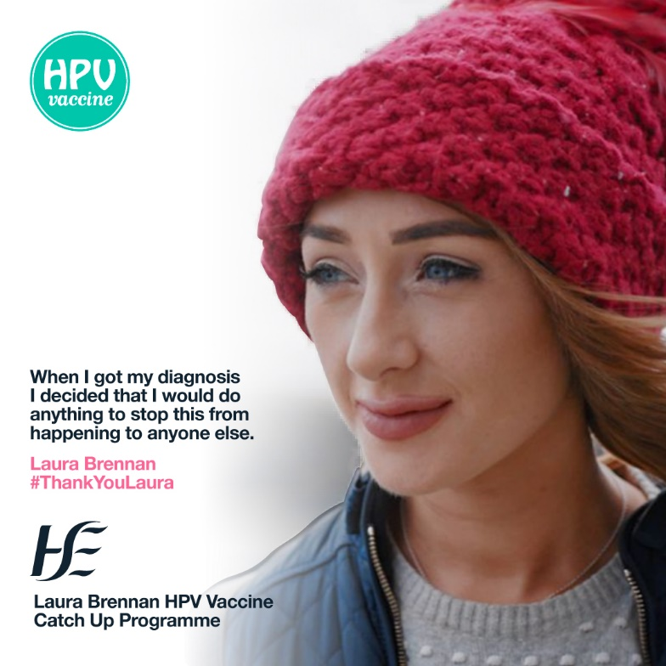
Social media
Sample messages:
If your child didn't get the HPV vaccine when it was offered to them at school, they could be eligible to get it now, for free, as part of the Laura Brennan HPV Vaccine Catch-Up Programme.
Only one dose of vaccine is needed.
Find out more at hpv.ie
#GetTheFacts #GetTheVaccine #ProtectOurFuture #ThankYouLaura
The HPV vaccine protects against 9 out of 10 cervical cancers.
Research has shown that the vaccine is safe and that the vaccine’s protection does not weaken over time.
Find out more about the HPV Vaccination Programme in schools at hpv.ie
#GetTheFacts #GetTheVaccine #ProtectOurFuture
Link: hpv.ie
Sample images:

Slide 6
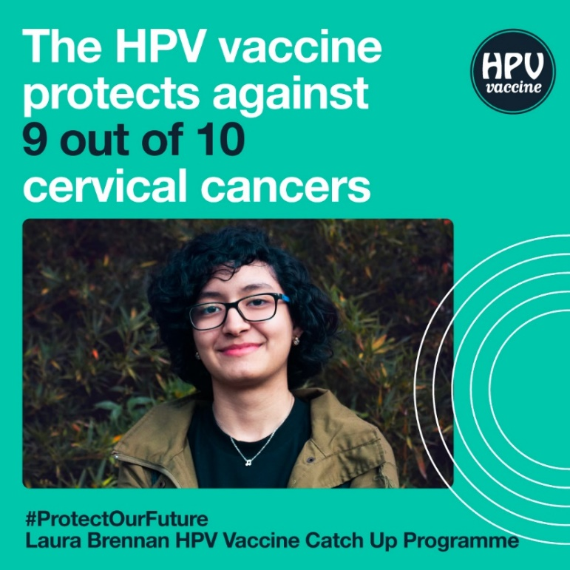
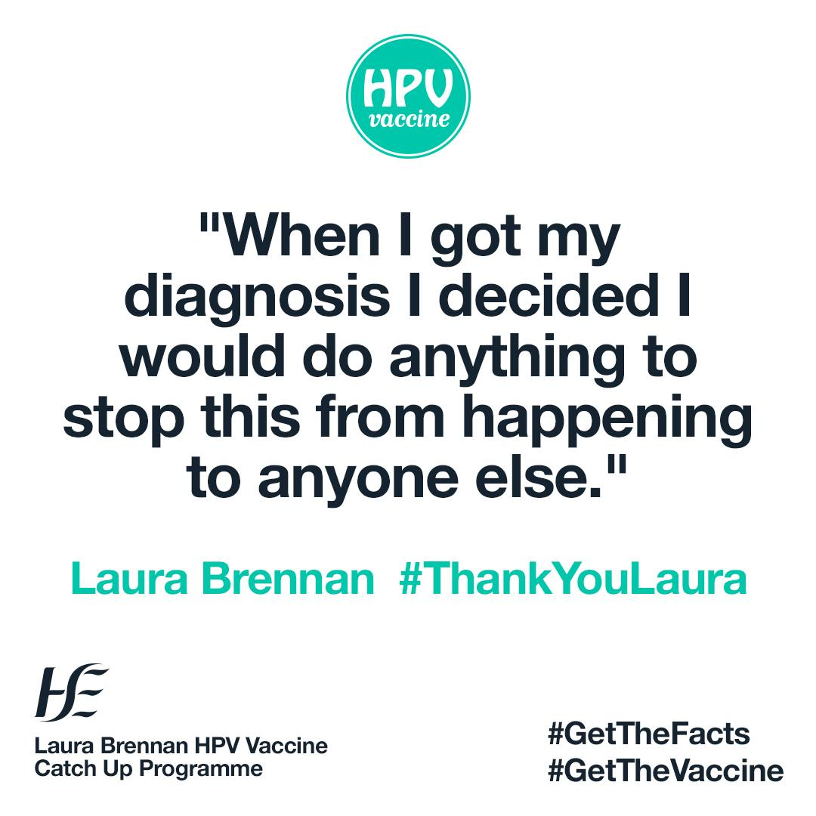
Social media
Sample messages:
The HPV vaccine is safe and effective.
Gardasil 9 is the name of the HPV vaccine currently used in Ireland.
Over 100 million people have been fully vaccinated with Gardasil worldwide. This includes over 500,000 people in Ireland. Get the facts at hpv.ie
#GetTheFacts #GetTheVaccine #ProtectOurFuture
The HPV vaccine protects you from getting HPV.
The more people vaccinated, the better we can reduce the number of HPV-related cancers.
Protect yourself by registering for the Laura Brennan HPV Vaccine Catch-up Programme at www.hpv.ie
#ThankYouLaura
Link: hpv.ie
Sample images:

Slide 7
How you can help
We welcome your ongoing help, support and partnership.
Share our social media messages
You can support the campaign by reposting and sharing posts from the HSE on our official accounts.
Facebook Page: facebook.com/HSElive
Instagram: instagram.com/irishhealthservice
Twitter: @HSELive
TikTok: @hselive
Please share with your networks
Thank you
If you have any queries or ideas, please contact partner.pack@hse.ie, or visit hse.ie/communications.
Thanks for supporting the campaign.

