Slide 1





February 2022
Partner Pack

Slide 2
COVID-19 vaccine for children aged 5 to 11
COVID-19 vaccines are now available to all children aged 5 to 11.
Getting your child vaccinated is a decision between you and your child. You should read advice on the HSE website before you decide.
Benefits of getting a COVID-19 vaccine
COVID-19 vaccines should protect your child from getting seriously ill from COVID-19. The vaccine is particularly recommended if children:
have a health condition that puts them at higher risk of severe illness from COVID-19
live with someone who is at higher risk of COVID-19
It is rare that COVID-19 causes serious illness in children.
It may also protect healthy children from:
COVID-19 illness which can be severe in very rare cases
multisystem inflammatory syndrome due to COVID-19
the risk of developing ‘long COVID' symptoms, such as fatigue, which can continue for weeks or months
spreading COVID-19 to others
Children who are vaccinated will be less likely to miss school and other activities because of being ill with COVID-19.
Vaccine type
Your child will be offered the Pfizer/BioNTech COVID-19 vaccine. The vaccine for children aged 5 to 11 is a smaller dose than the one offered to people aged 12 and over. The immunity they get will be similar to the higher dose vaccine used in older age groups.
They will need 2 doses, 3 weeks apart.
If your 5 to 11 year old child had COVID-19, they need to wait 4 weeks before they get their vaccine.

Slide 3
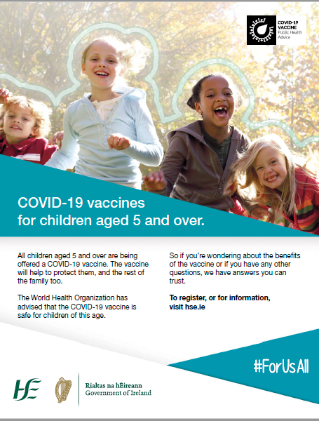
Media
Our new campaign for parents of children aged 5 to 11 is live across TV, radio, press, social and digital media. It directs parents of 5 to 11 year olds to hse.ie for trusted information to help them make an informed decision on their child’s vaccine.
TV: A new TV ad first aired on Thursday, February 10th. You can watch the ad here. An Irish language version of the ad will also feature on TG4.
Radio: Live on a wide range of national and local stations. You can listen to the radio ad here.
You can listen to the Irish language radio ad here.
Press: Full page newspaper ads ran in all national papers and local papers (see below).

Slide 4
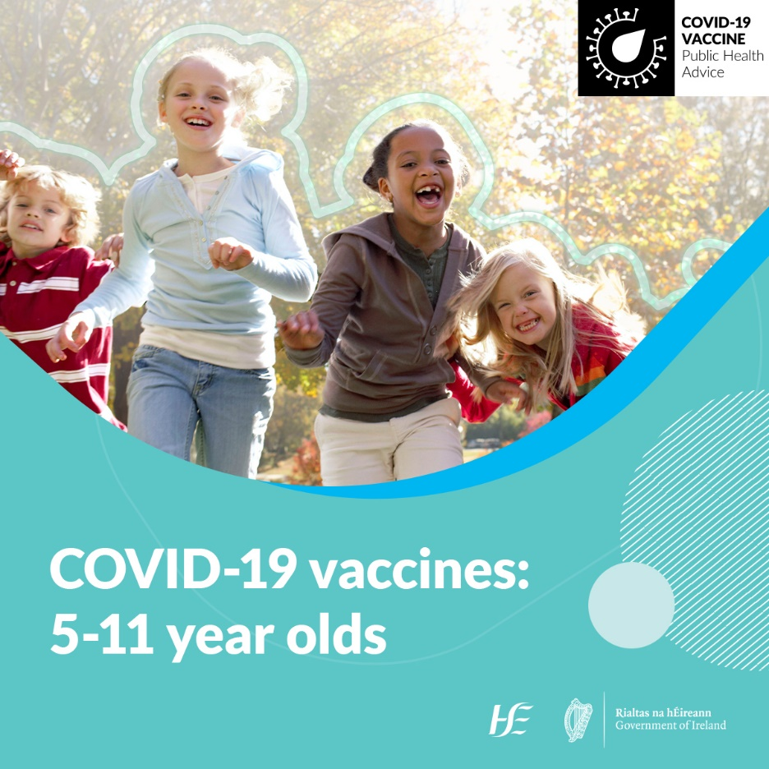
Social media
Sample message: General
All children aged 5 and over are being offered a COVID-19 vaccine. The vaccine will help to protect them and the rest of the family too. Getting your child vaccinated is a decision between you and your child. Read our advice to help you decide.
Sample message: More than one child?
All children aged 5 and over are being offered a COVID-19 vaccine. If you have more than one child aged 5 to 11 getting vaccinated, you can bring them to the same appointment time.
Want to use this image?
Right click and select
‘save as picture’
More information: COVID-19 vaccine for 5-11 year olds

Slide 5
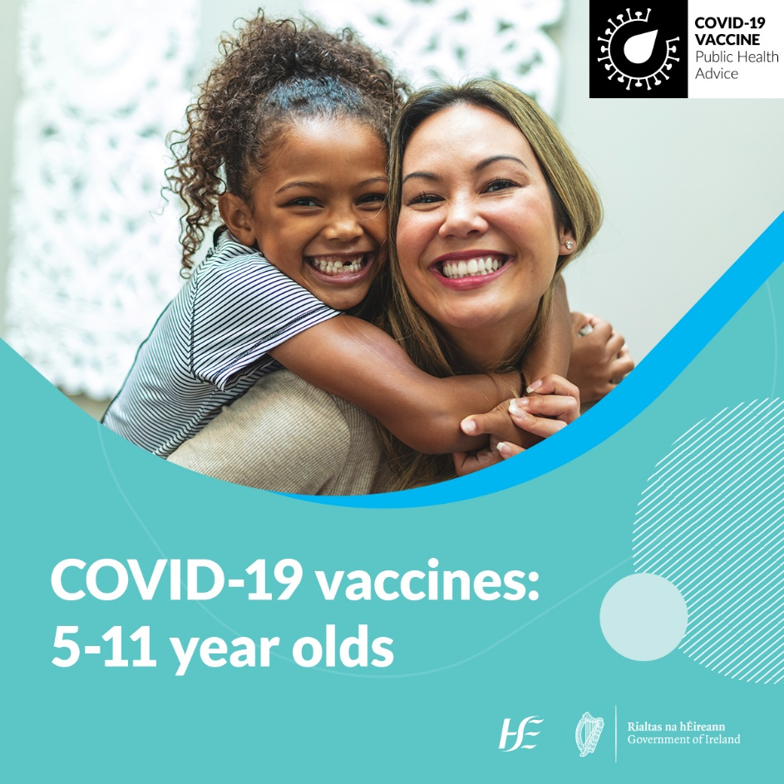
Social media
Sample message: Child had COVID-19
All children aged 5 to11 are being offered a COVID-19 vaccine. Delay getting your child vaccinated if they had COVID-19 in the last 4 weeks.
Sample message: Registration and Consent
COVID-19 vaccine registration is open for all children aged 5 to 11. A parent or legal guardian will need to register and give consent for their child to get their COVID-19 vaccine.
Want to use this image?
Right click and select
‘save as picture’
More information: COVID-19 vaccine for 5-11 year olds

Slide 6

COVID-19 Vaccine Information
Clear information helps us all to make an informed decision about the vaccine.
You can find factual, updated information about COVID-19 Vaccine on www.hse.ie/covid19vaccine.
You can phone our team in HSELive on
1800 700 700.
You can email HSElive at hselive@hse.ie
Remote sign language interpretation can be arranged by appointment.
Go to our official social media channels for up to date news, videos, links and walk-in clinic details.
Downloadable information materials on the vaccines are available on www.hse.ie/covid19vaccinematerials
Vaccine information is available on this website in:
Over 24 languages, in both video and in information booklets.
Easy-Read format
Irish Sign Language
Audio, large print and braille

Slide 7

Please share with your networks
Thank you
#ForUsAll

