Slide 1
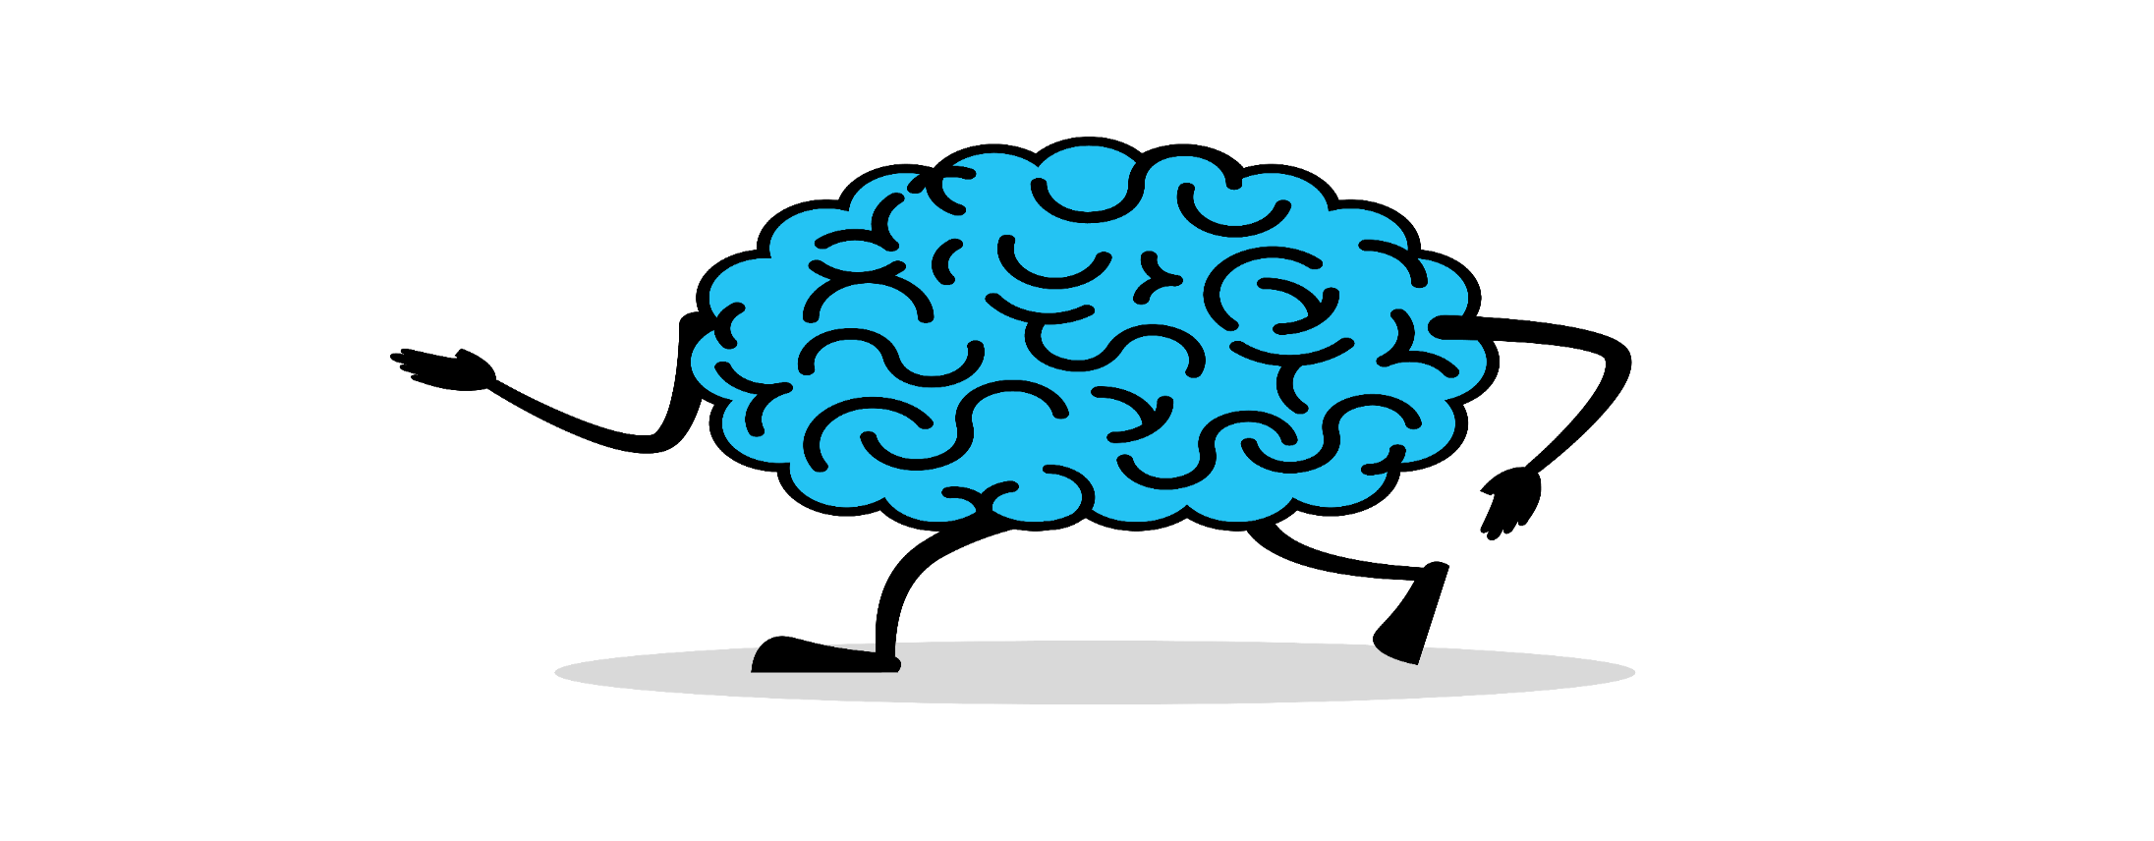
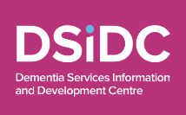
National Brain Awareness Week
#LoveYourBrain
Partner Pack for
Organisations and Community Champions

Slide 2
National Brain Awareness Week
takes place from March 13th to 19th, 2023
The Dementia: Understand Together campaign, led by the HSE in partnership with the Alzheimer Society of Ireland, Age Friendly Ireland, Age & Opportunity, Healthy Ireland and the Dementia Services Information and Development Centre, is encouraging everyone to make simple changes to help maintain brain health and reduce the risk of developing some types of dementia.
A Lancet study in 2020 identified 12 modifiable risk factors that could account for 40% of dementia worldwide and we are highlighting a number of these factors, creating awareness of the link with dementia and how people in their midlife can reduce their risk.
Proactive steps people can take include
being physically active
eating a healthy balanced diet
quitting smoking
managing blood pressure
making time for social connection and interaction
It’s always a good time to improve brain health and reduce your risk of Dementia and adopting these habits in adulthood can play an important part in reducing risk, as well as developing good routines for life.

Slide 3
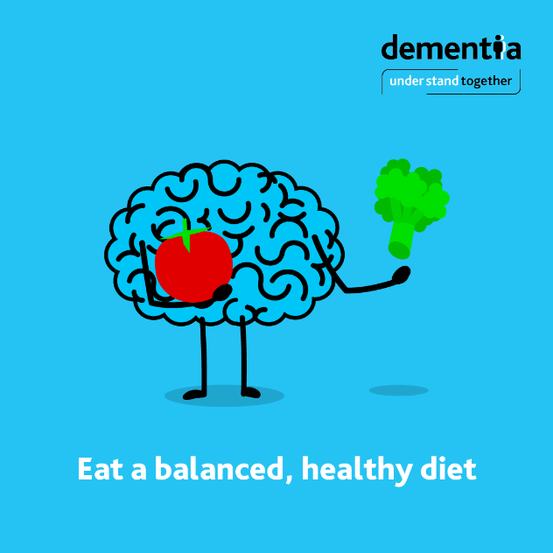
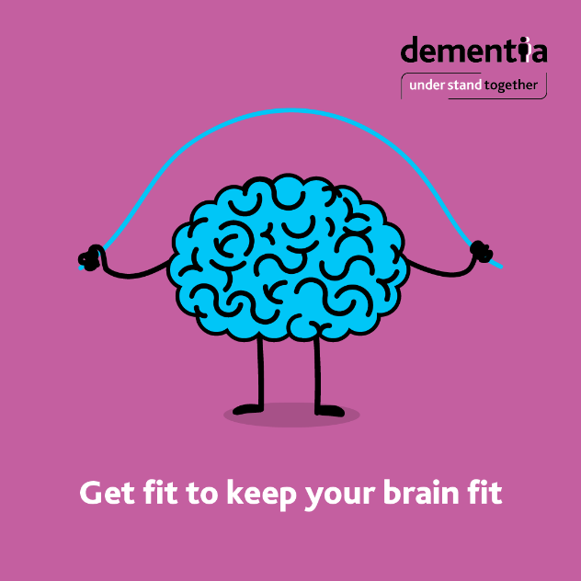
Here are 4 simple ways to keep your brain healthy and help reduce your risk of dementia:
Eating a wide variety of nourishing foods provides the energy and nutrients you need to keep your brain healthy and may help reduce your risk of dementia. A balanced diet that is rich in vegetables, fruit, wholegrains, and fish, and is low in salt and sugar, is a good starting point. Achieving or maintaining a healthy weight during your lifetime, particularly in mid-life is also important; being more active and following a healthy diet can help this.
Physical activity is very important for brain health and exercise has been shown to reduce the risk of dementia. Every adult should aim to include 150 minutes of physical activity in their week, this equates to a brisk 30-minute walk, five days a week. A brisk walk should raise your heart rate but not leave you breathless.

Slide 4
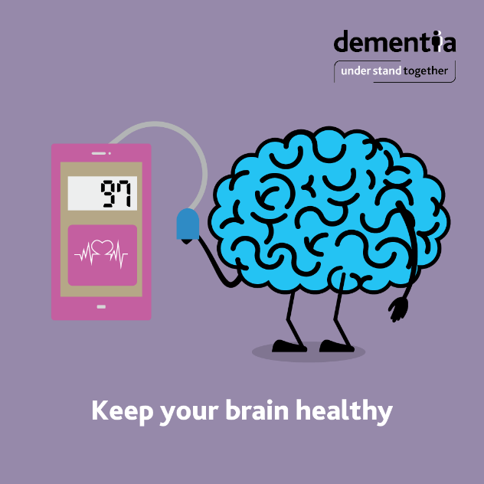
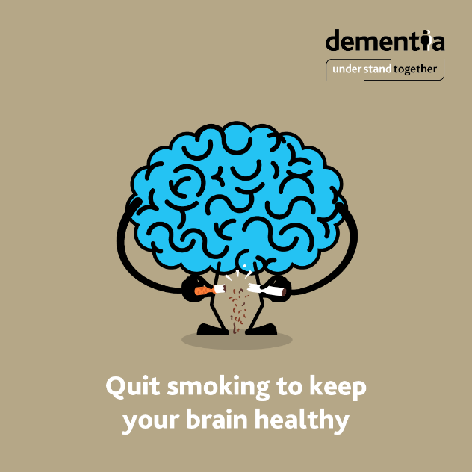
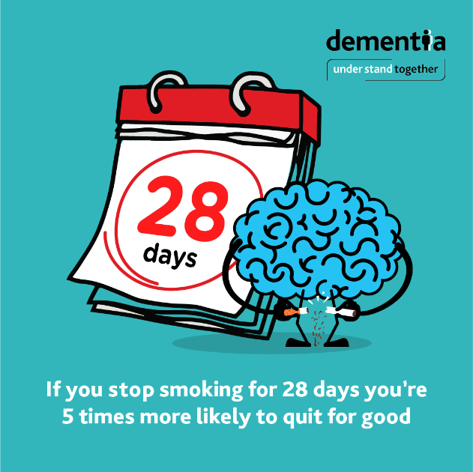
High blood pressure damages the blood vessels that supply the brain, and this in turn can damage brain cells. By controlling high blood pressure you may be able to reduce your risk of dementia. Healthy adults should check their blood pressure at least once a year. www.understandtogether.ie/about-dementia/what-is-dementia/brain-health
Quitting smoking may reduce your risk of developing dementia (as well as reducing your risk of developing cancers and heart disease). It can be hard to quit, but if you stop smoking for 28 days, you’re five times more likely to stop for good. If you’re ready to quit, the HSE QUIT team are ready to help. For free support call 1800 201 203 or text them for free on 50100 and receive a call back, or visit www.quit.ie/

Slide 5
Promotional video

Slide 6
Support the campaign
We welcome your support in raising awareness for National Brain Awareness Week by posting or sharing key messages.
Facebook: https://www.facebook.com/dementiaunderstandtogether/
Hashtag: #UnderstandTogether
Thank you
For more information on the
Dementia: Understand Together Campaign please visit
www.understandtogether.ie

