Slide 1
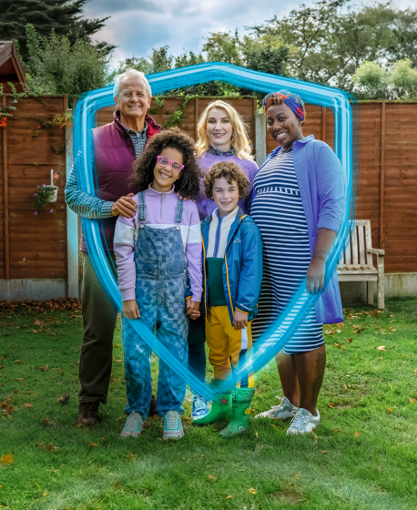
Slide Templates
For HSE and Funded Agencies
Winter Vaccines Campaign Partner Pack Oct 2022

Slide 2
Winter Vaccines Campaign
The HSE has developed a new advertising campaign that aims to promote and encourage people in Ireland to get their recommended winter vaccines (flu and COVID-19).
This campaign brings flu and COVID-19 vaccines together for our key audiences – older people (this includes new 65+ cohort for their next booster but also anyone aged 50+ who’s yet to get their COVID-19 booster), healthcare workers, parents of children, people with long term conditions, and anyone who’s pregnant.
The campaign is informed by research on public attitudes and behaviours around COVID-19 and in-depth qualitative research.
Some of the main insights from people who took part are:
People are very ‘immune’ aware, about how they’re supporting their own immune systems coming into the winter – healthy eating, exercise etc.
People are motivated by the fact that vaccines are one more thing in their arsenal to help keep them and their families protected this winter.
People want agency over their decisions once more – there was a strong reaction against anything that was seen as an ‘order’ to go and get vaccinated, seen as a throwback to COVID.
The TV ad particularly uses two visual metaphors that helped people to understand the personal benefits of vaccination – a coffee cup topping up and a phone charging.
The use of a shield around protected character demonstrates strengthened immunity from vaccines.

Slide 3
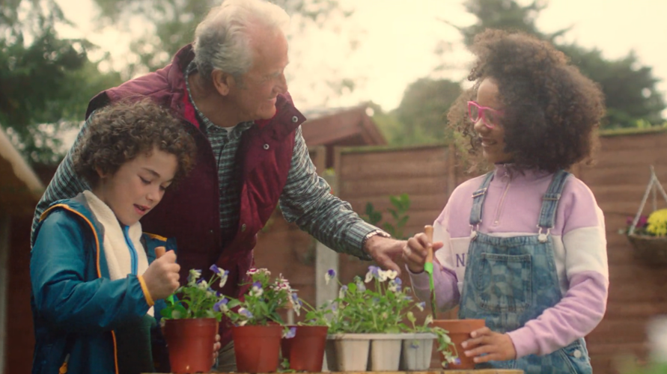
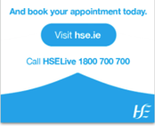
Time to Top-Up - Campaign channels and assets
‘Time to Top-Up’ encourages people to get their recommended winter vaccines (flu and COVID-19).
Our message – Flu and COVID-19 vaccines give your immune system the top-up it needs to help protect you from serious illness.
TV
TV and video-on-demand (VOD) will be on air from 7 Oct. Watch the TV ad here.
Radio
Radio ads are running on national, local and digital radio since 3 October. Listen to our general radio ad and ad targeted specifically at pregnancy. We will also have dynamic audio running to deliver audio ads in the language of the person listening.
Print
Print ads appearing in national papers and local papers throughout the week commencing 3 Oct. Print ads will also appear in key foreign language press in coming weeks.
Digital display
A range of online digital display messages will roll out over the winter.
Social media
Social media messages are always on across Facebook, Twitter, Instagram and TikTok.

Slide 4
Additional Winter Communications
Additional channels and assets will be added to our media plans.
Children’s flu – Additional channels and assets will be added to our media plans specifically for children’s nasal spray flu vaccine for all children aged 2 to 17 will be added from 17th October. Specifically VOD, digital display and radio.
Injury units- Local radio ads and paid search ads to run over winter. A winter insert for local papers will include information on accessing health services including injury units in mid-November. See here for more information.
Keeping well this winter - Messaging around keeping well over winter and treating common winter illnesses will be on social channels and paid search over winter. There will also be information on this topic in a winter insert for local papers. For information on keeping well this winter, see our up-to-date information here.
COVID-19 protective measures – Messaging around the behaviours which help protect us all from COVID-19 will continue throughout the winter.

Slide 5
How you can help
We welcome your ongoing help, support and partnership.
1.Support the campaign
You can view and share the TV ad at the link below:
https://youtu.be/IBxdYLOLEHE
Please share the video with your own message or post it to your social pages tagging @HSELive.
Facebook Page: facebook.com/HSElive
Instagram: instagram.com/irishhealthservice
Twitter: @HSELive
TikTok: @hselive
2.Share our social media messages
You can support the campaign by reposting and sharing posts from the HSE on our official accounts.
You can also share some of the social media messages and images on the next pages.
Thank you for your ongoing support – it makes a big difference.

Slide 6
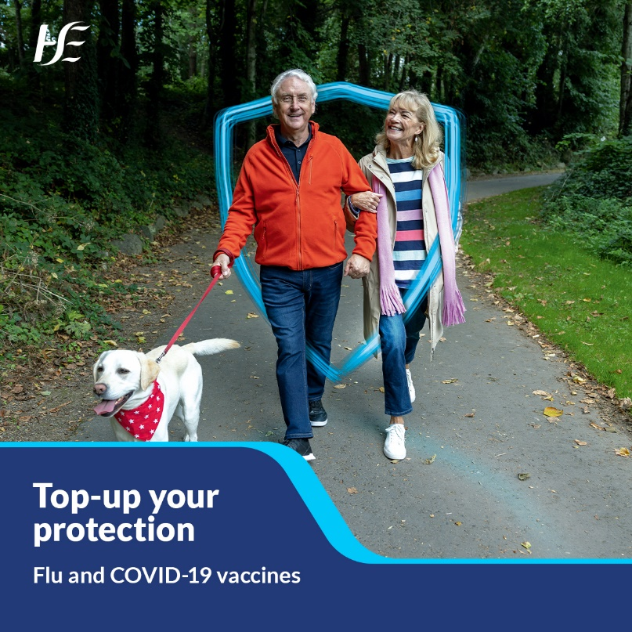
Social media
Sample messages and images:
For all audiences:
Top-up your immunity with the COVID-19 and flu vaccines to make sure you're protected in the months ahead. See what vaccines are recommended for you and make an appointment today.
Link: https://www2.hse.ie/screening-and-vaccinations/vaccines/
For people 65 or over:
People 65 or over are more at risk of serious complications from flu and COVID-19. Protect yourself and others this winter. Book your FREE vaccines from a GP or pharmacy today.
Link: https://www2.hse.ie/screening-and-vaccinations/vaccines/

Slide 7
Social media
Sample messages and images:
For parents:
Top-up your child's immunity with the COVID-19 and flu vaccines to make sure they are protected in the months ahead. See what vaccines are recommended for your child and book an appointment today.
Link: https://www2.hse.ie/screening-and-vaccinations/vaccines/
For pregnancy:
Both flu and COVID-19 can cause serious illness in pregnancy and your COVID-19 and flu vaccines will help protect you and your baby. Book an appointment today or speak to your doctor or midwife.
Link: https://www2.hse.ie/screening-and-vaccinations/vaccines/

Slide 8
Please share with your networks
Thank you
If you have any queries or ideas, please contact partner.pack@hse.ie, or visit hse.ie/communications.
Thanks for supporting the campaign.

